Slide 1
Chapter 31 Web Services
Java How to Program, 8/e

Slide 2
Introductory Soap application
http://netbeans.org/kb/docs/websvc/jax-ws.html

Slide 3
How to build a Soap Application
Requirements:
NetBeans IDE 6.9 requires JDK 6
JDK 6 update 7 or later
Java Development Kit
Tomcat Web Server 6.0
GlassFish 3.1(open source)

Slide 4
Tomcat vs Glassfish Servers
Standard features Tomcat Glassfish Comment
Adoption levels high low Glassfish is new
Scalable ok yes Glassfish has grizzly
Includes Java EE 5 jars no yes
Dependency injection no yes
Container managed transactions no yes
OpenJPA entities enhanced automatically no yes
JDBC authentication yes yes In Glassfish 1.0.1
Virtual server features
Support for virtual hosting yes yes
Deploy same webapp to multiple hosts yes yes
Configure same webapp differently yes no Possible in Tomcat's context.xml or server.xml
Per virtual host logging ok yes Tomcat's JULI is a bit buggy
Each host has their own authentication realm yes no
Each host has their own deployment dir yes no
Each host has a jailed manager yes no
Each host can listen on a different port ok yes Tomcat requires an additional <Service> containers
Each host listens on arbitrary combination of ports no yes For Tomcat, a host in one <Service> cannot share ports with a host in another <Service>

Slide 5
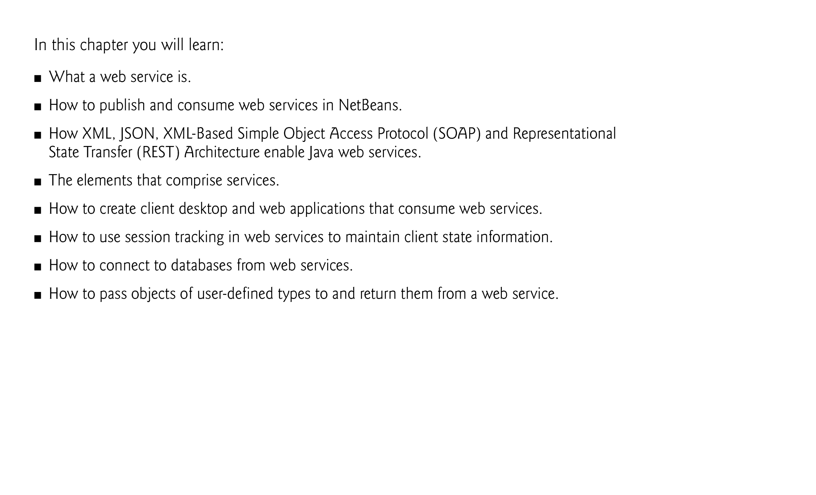

Slide 6
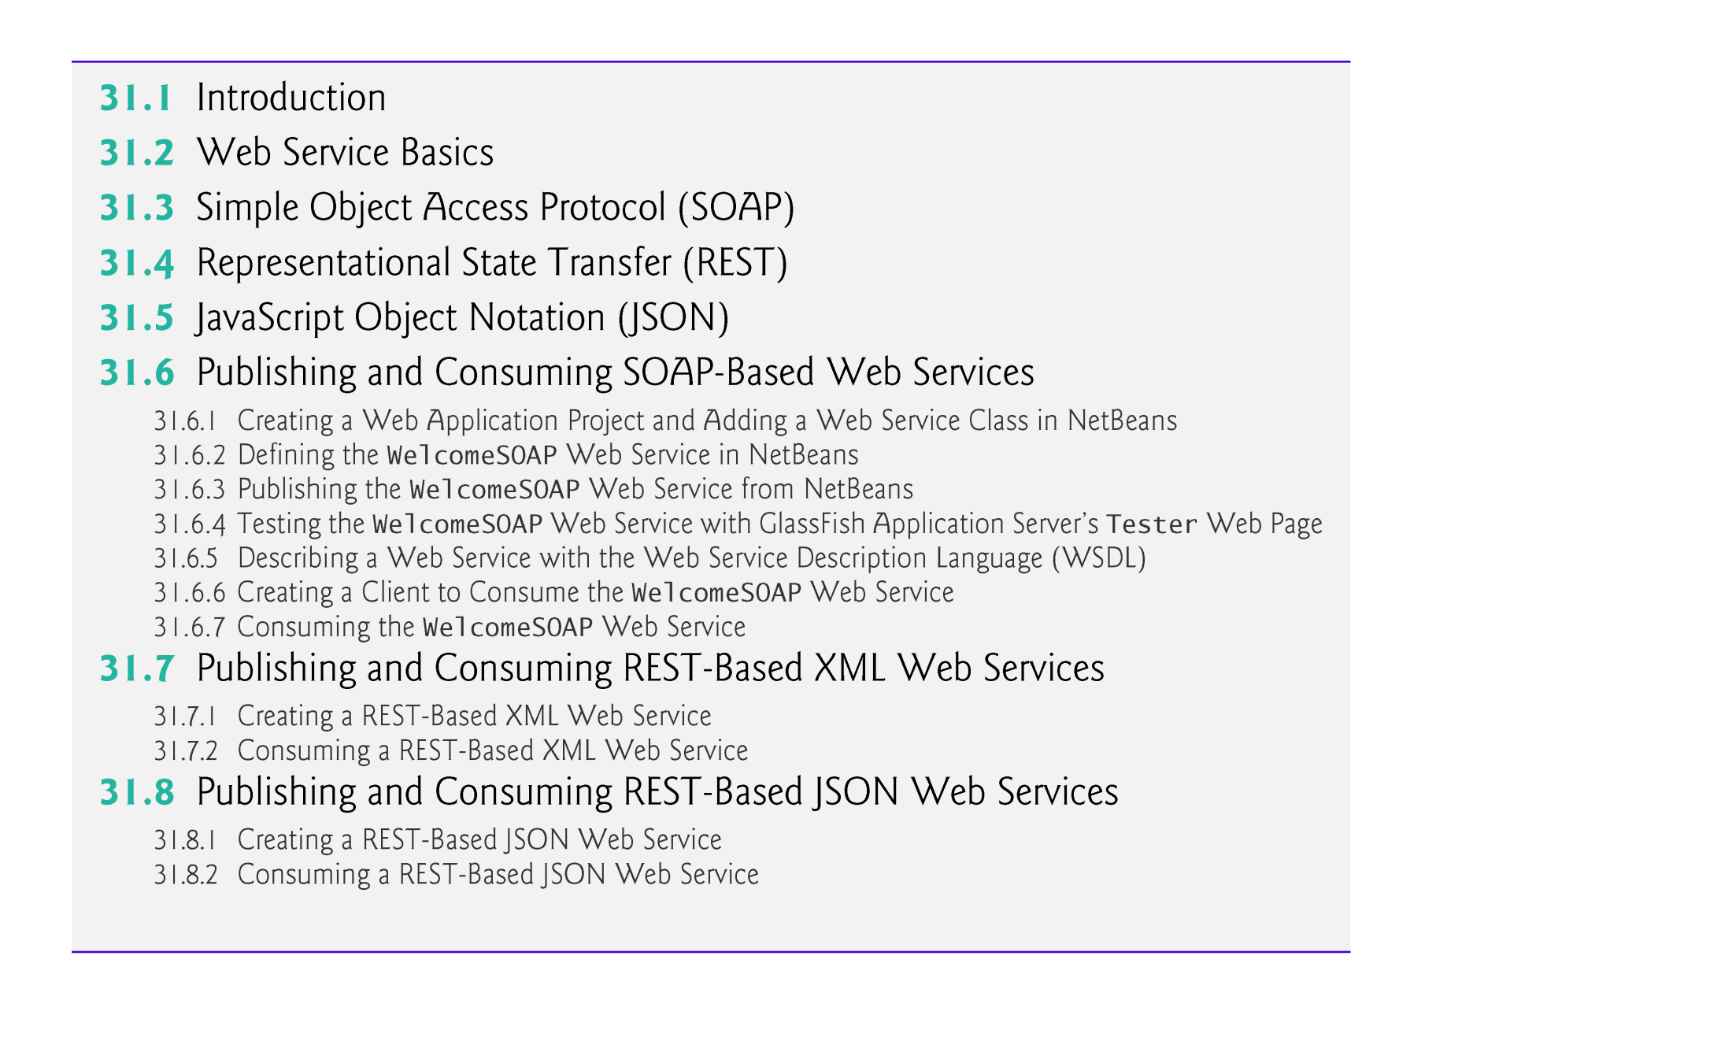

Slide 7
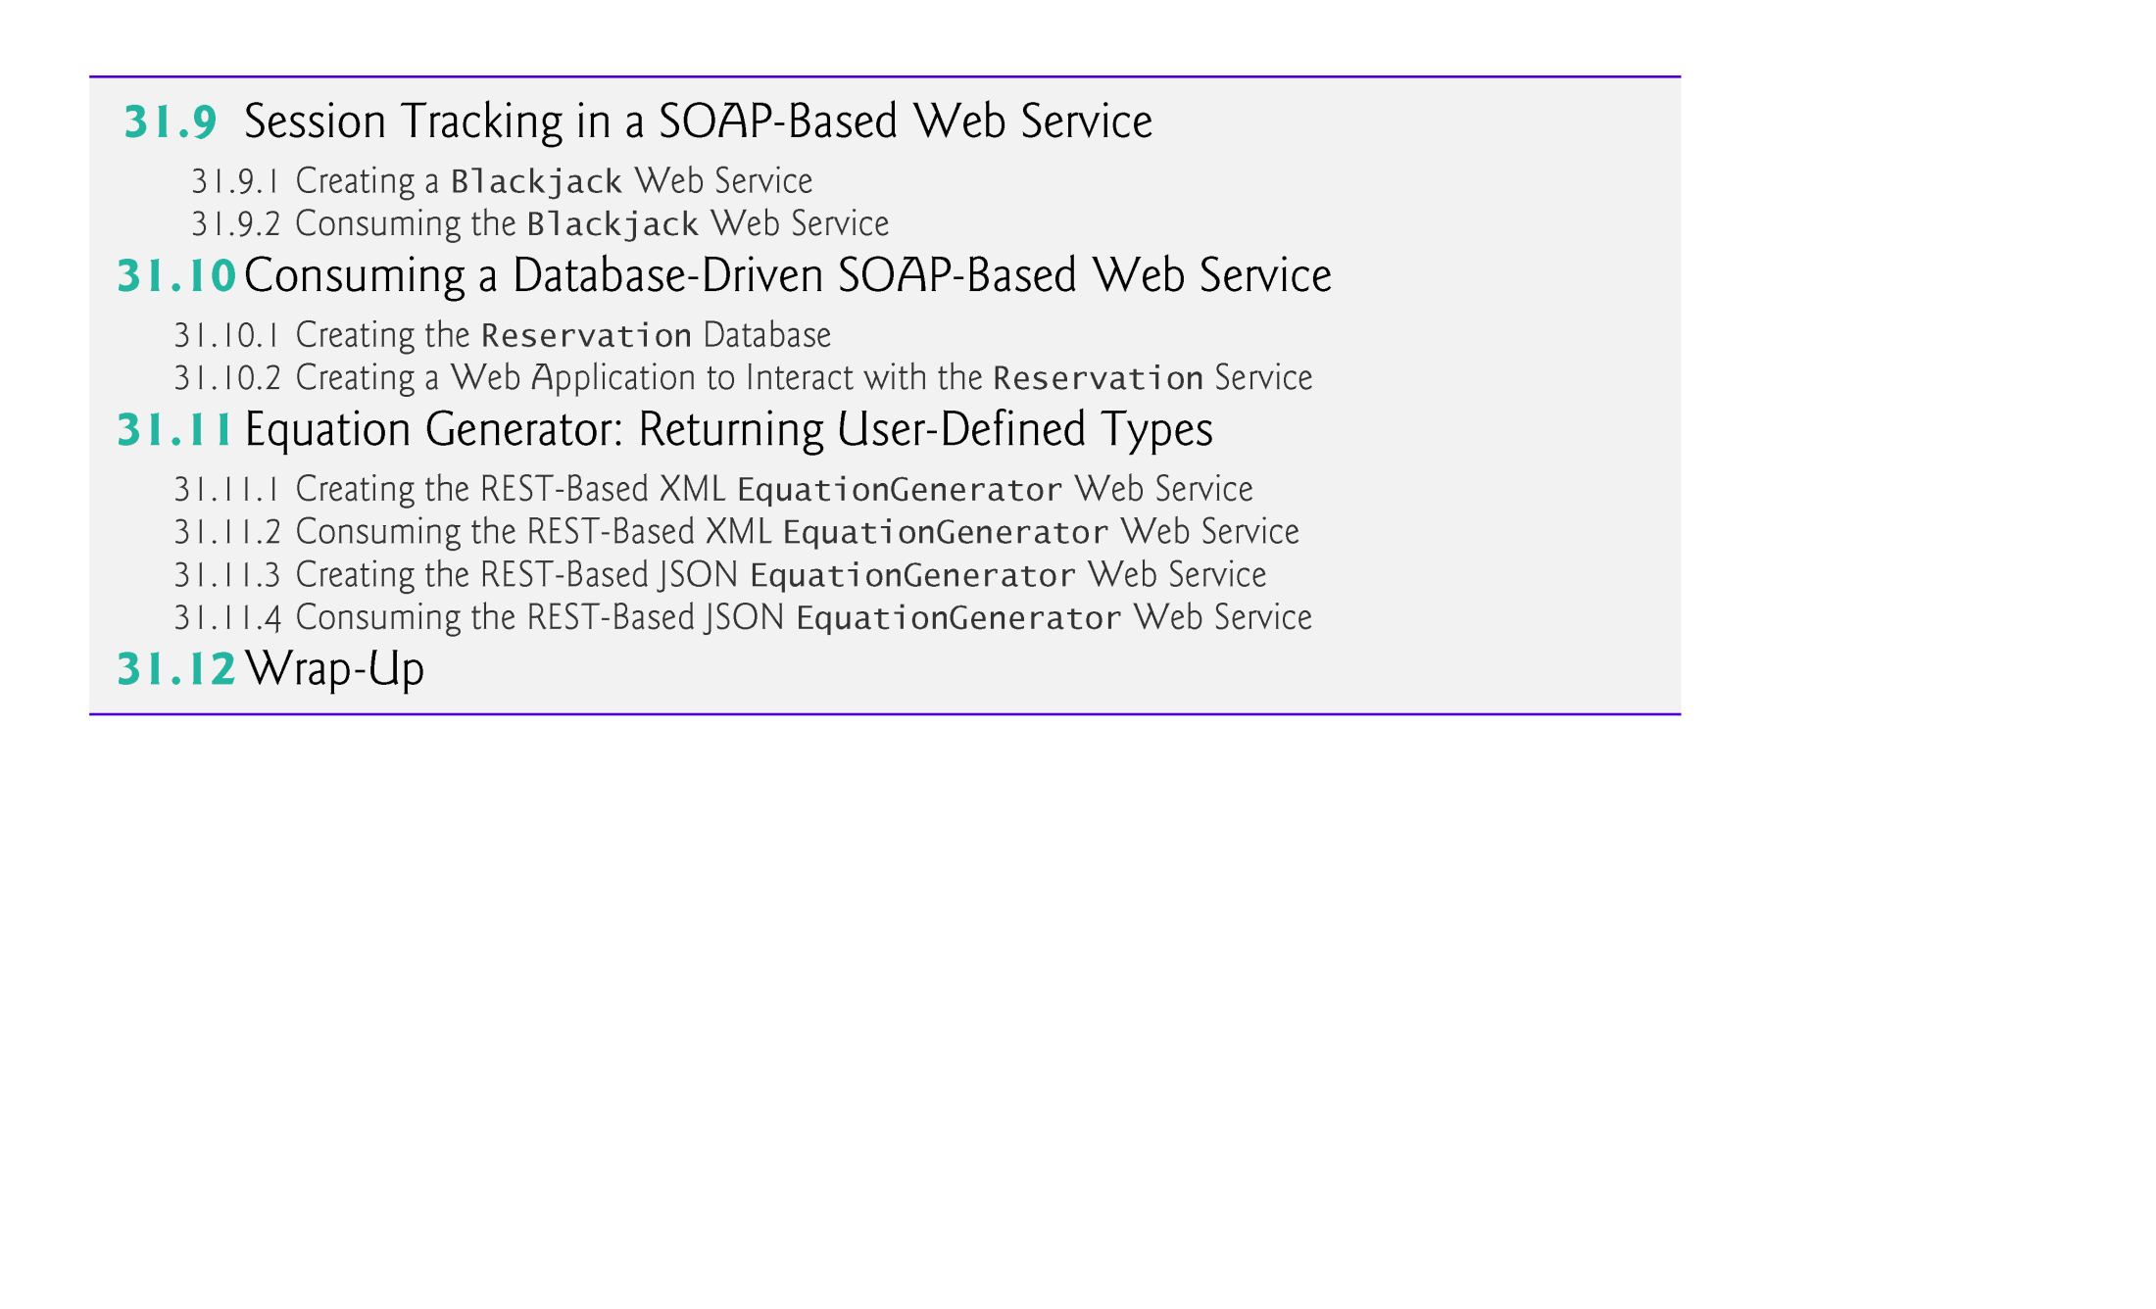

Slide 8
31.1 Introduction
A web service is a software component stored on one computer that can be accessed by an application (or other software component) on another computer over a network.
Web services communicate using such technologies as XML, JSON and HTTP.
In this chapter, we use two Java APIs that facilitate web services.
JAX-WS is based on the Simple Object Access Protocol (SOAP)—an XML-based protocol that allows web services and clients to communicate, even if the client and the web service are written in different languages.
JAX-RS uses Representational State Transfer (REST)—a network architecture that uses the web’s traditional request/response mechanisms such as GET and POST requests.

Slide 9
31.1 Introduction (cont.)
Business-to-Business Transactions
Rather than relying on proprietary applications, businesses can conduct transactions via standardized, widely available web services.
This has important implications for business-to-business (B2B) transactions.
Web services are platform and language independent, enabling companies to collaborate without worrying about the compatibility of their hardware, software and communications technologies.

Slide 10
31.2 Web Service Basics
The machine on which a web service resides is referred to as a web service host.
The client application sends a request over a network to the web service host, which processes the request and returns a response over the network to the application.
In Java, a web service is implemented as a class.
The class that represents the web service resides on a server—it’s not part of the client application.
Making a web service available to receive client requests is known as publishing a web service; using a web service from a client application is known as consuming a web service.

Slide 11
31.3 Simple Object Access Protocol (SOAP)
The Simple Object Access Protocol (SOAP) is a platform-independent protocol that uses XML to make remote procedure calls, typically over HTTP.
Each request and response is packaged in a SOAP message.
Written in XML so that they are computer readable, human readable and platform independent.
Most firewalls allow HTTP traffic to pass through, so that clients can browse the web by sending requests to and receiving responses from web servers.
Thus, SOAP-based services can send and receive SOAP messages over HTTP connections with few limitations.

Slide 12
31.3 Simple Object Access Protocol (SOAP) (cont.)
The wire format used to transmit requests and responses must support all types passed between the applications.
When a program invokes a method of a SOAP web service, the request and all relevant information are packaged in a SOAP message enclosed in a SOAP envelope and sent to the server on which the web service resides.
When the web service receives this SOAP message, it parses the XML representing the message, then processes the message’s contents.
The message specifies the method that the client wishes to execute and the arguments the client passed to that method.
The web service calls the method with the specified arguments (if any) and sends the response back to the client in another SOAP message.
The client parses the response to retrieve the method’s result.

Slide 13
31.4 Representational State Transfer (REST)
Representational State Transfer (REST) refers to an architectural style for implementing web services.
Often called RESTful web services.
RESTful web services are implemented using web standards.
Each method in a RESTful web service is identified by a unique URL.
Thus, when the server receives a request, it immediately knows what operation to perform.
Can be used in a program or directly from a web browser.
The results of a particular operation may be cached locally by the browser when the service is invoked with a GET request.

Slide 14
31.5 JavaScript Object Notation (JSON)
JavaScript Object Notation (JSON) is an alternative to XML for representing data.
Text-based data-interchange format used to represent objects in JavaScript as collections of name/value pairs represented as Strings.
Commonly used in Ajax applications.
Makes objects easy to read, create and parse
Much less verbose than XML, so it allows programs to transmit data efficiently across the Internet

Slide 15
31.5 JavaScript Object Notation (JSON) (cont.)
Each JSON object is represented as a list of property names and values contained in curly braces:
{ propertyName1 : value1, propertyName2 : value2 }
Arrays are represented with square brackets:
[ value1, value2, value3 ]
Each value in an array can be a string, a number, a JSON object, true, false or null.
Representation of an array of address-book entries:
[ { first: 'Cheryl', last: 'Black' }, { first: 'James', last: 'Blue' }, { first: 'Mike', last: 'Brown' }, { first: 'Meg', last: 'Gold' } ]

Slide 16
31.6 Publishing and Consuming SOAP-Based Web Services
This section presents our first example of publishing (enabling for client access) and consuming (using) a web service.
We begin with a SOAP-based web service.

Slide 17
31.6.2 Defining the WelcomeSOAP Web Service in NetBeans
Figure 31.1 contains the WelcomeSOAP web service’s code.
You can find this file in the project’s src\java\com\deitel\welcomesoap folder.
By default, each new web service class created with the JAX-WS APIs is a POJO (plain old Java object)
You do not need to extend a class.

Slide 18
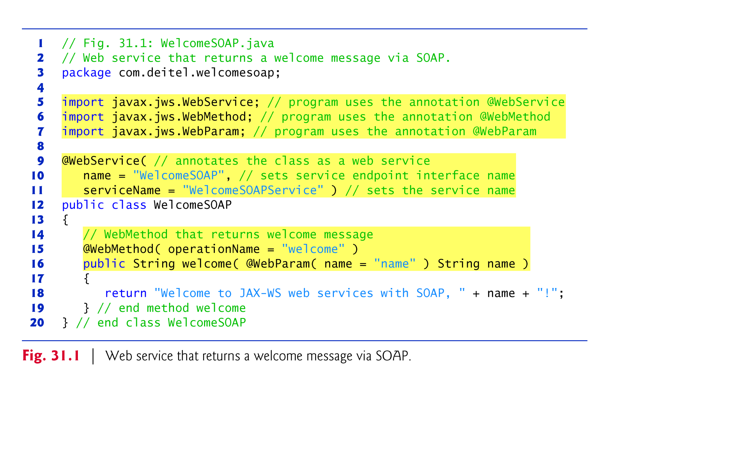

Slide 19
31.6.2 Defining the WelcomeSOAP Web Service in NetBeans (cont.)
When you deploy a web application containing a class that uses the @WebService annotation, the server recognizes that the class implements a web service and creates all the server-side artifacts that support the web service
Framework that allows the web service to wait for client requests and respond to those requests once it is deployed on an application server.

Slide 20
31.6.2 Defining the WelcomeSOAP Web Service in NetBeans (cont.)
The @WebService annotation indicates that a class implements a web service.The annotation is followed by parentheses containing optional annotation attributes.
The name attributespecifies the name of the service endpoint interface class that will be generated for the client.
A service endpoint interface (SEI) class (sometimes called a proxy class) is used to interact with the web service
a client application consumes the web service by invoking methods on the service endpoint interface object.
The serviceName attribute specifies the service name, which is also the name of the class that the client uses to obtain a service endpoint interface object.
If not specified, the web service’s name is assumed to be the java class name followed by the word Service.

Slide 21
31.6.2 Defining the WelcomeSOAP Web Service in NetBeans (cont.)
A method is tagged with the @WebMethod annotation to indicate that it can be called remotely.
Any methods that are not tagged with @WebMethod are not accessible to clients that consume the web service.
An @WebMethod annotation’s operationName attribute to specifies the method name that is exposed to the web service’s client.
If the operationName is not specified, it is set to the actual Java method’s name.
A parameter is annotated with the @WebParam annotation.
The optional @WebParam attribute name indicates the parameter name that is exposed to the web service’s clients.
If you don’t specify the name, the actual parameter name is used.

Slide 22
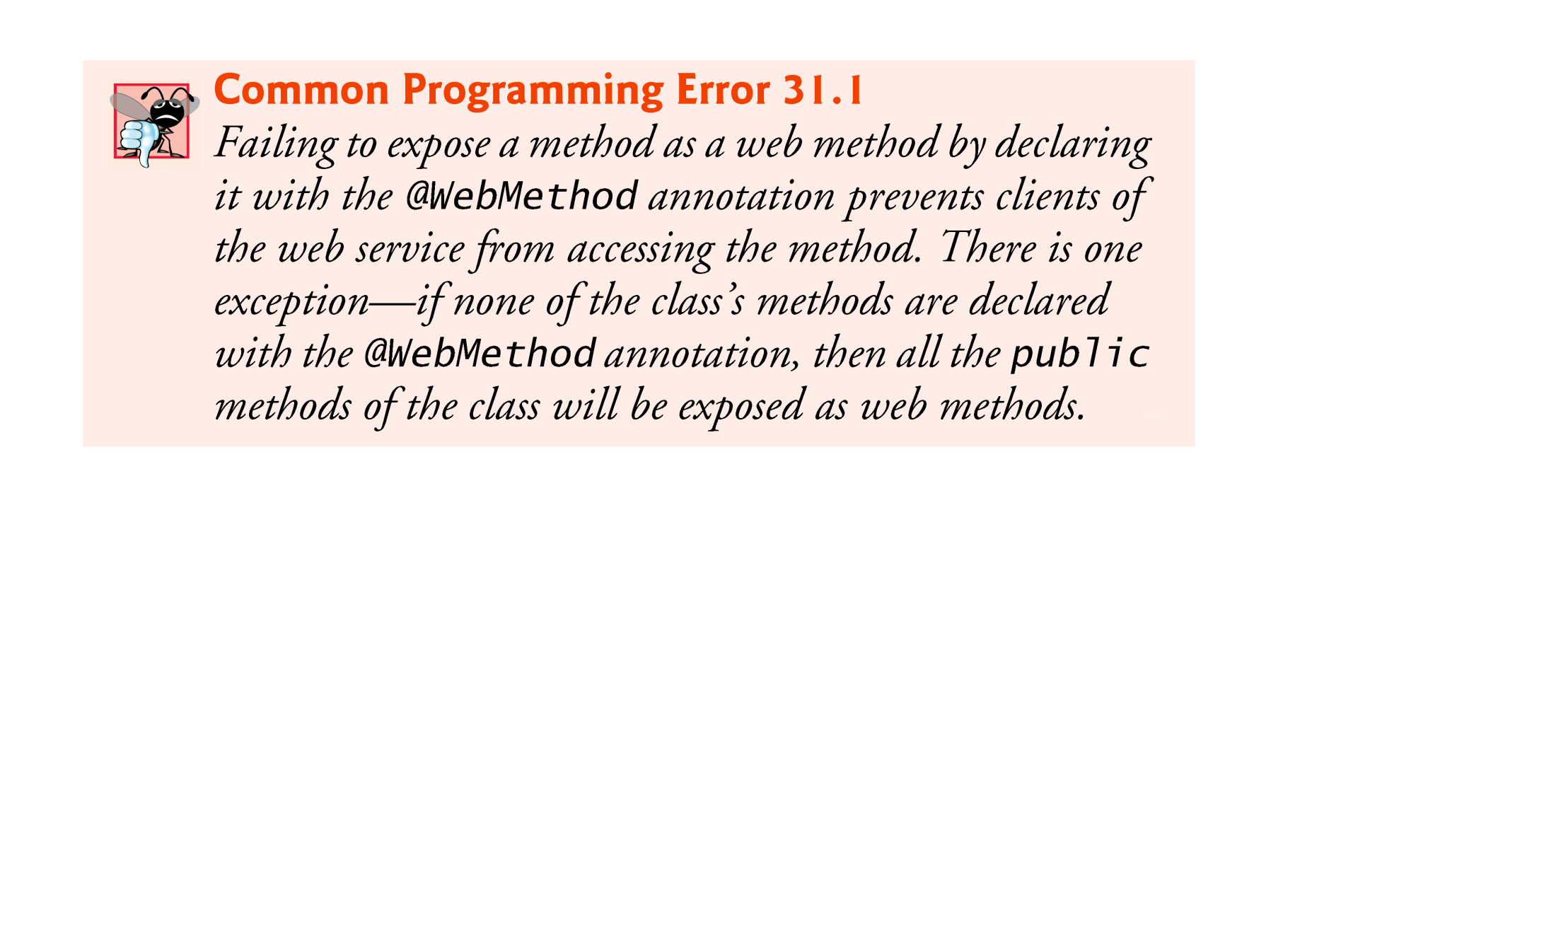

Slide 23
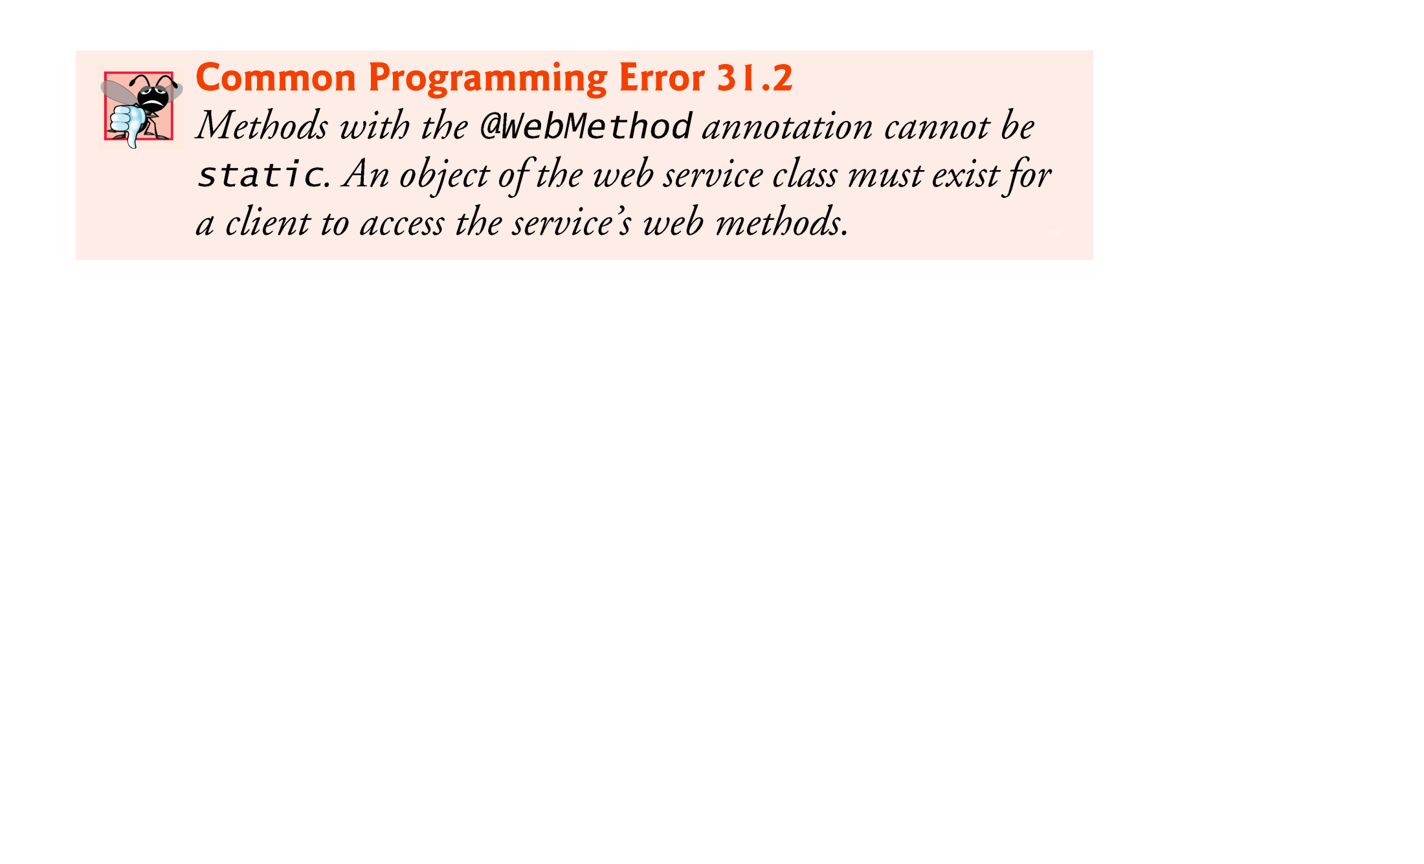

Slide 24
31.6.3 Publishing the WelcomeSOAP Web Service from NetBeans
NetBeans handles all the details of building and deploying a web service for you.
This includes creating the framework required to support the web service.
Right click the project name in the NetBeans Projects tab to display the pop-up menu in Fig. 31.2.
To determine if there are any compilation errors in your project, select Build.
When the project compiles successfully, select Deploy to deploy it to the server you selected when you set up the web application in Section 31.6.1.
If the code in the project has changed since the last build, selecting Deploy also builds the project.
Selecting Run executes the web application.
Both the Deploy and Run options also start the application server (in our case GlassFish) if it is not already running.

Slide 25
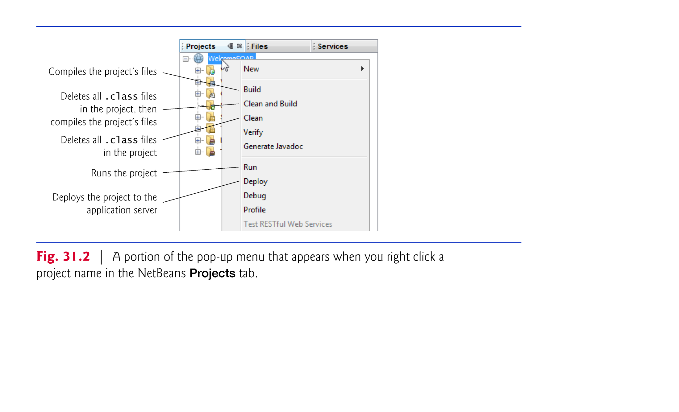

Slide 26
31.6.4 Testing the WelcomeSOAP Web Service with GlassFish Application Server’s Tester Web Page
The GlassFish application server can dynamically create a web page for testing a web service’s methods from a web browser.
Expand the project’s Web Services in the NetBeans Projects tab.
Right click the web service class name and select Test Web Service.
The GlassFish application server builds the Tester web page and loads it into your web browser (Figure 31.3).
Figure 31.4 shows the results of invoking WelcomeSOAP’s welcome method with the value John.

Slide 27
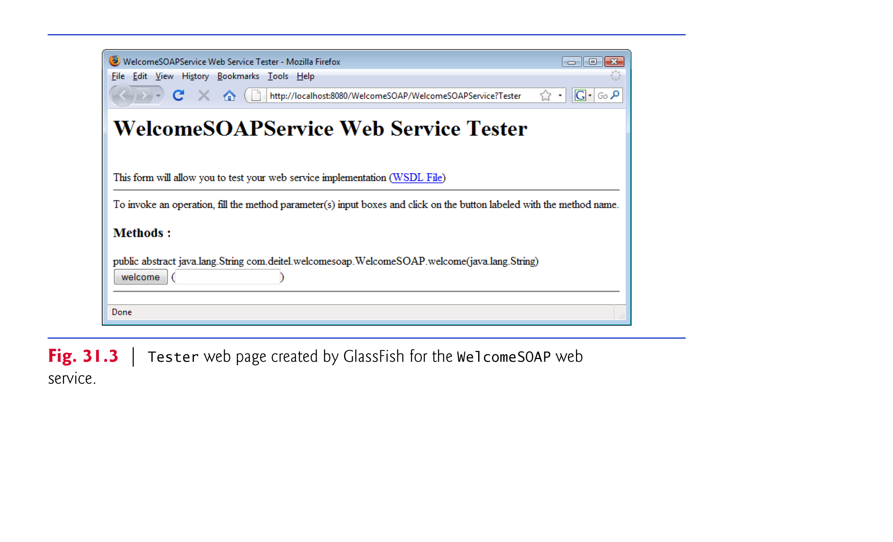

Slide 28
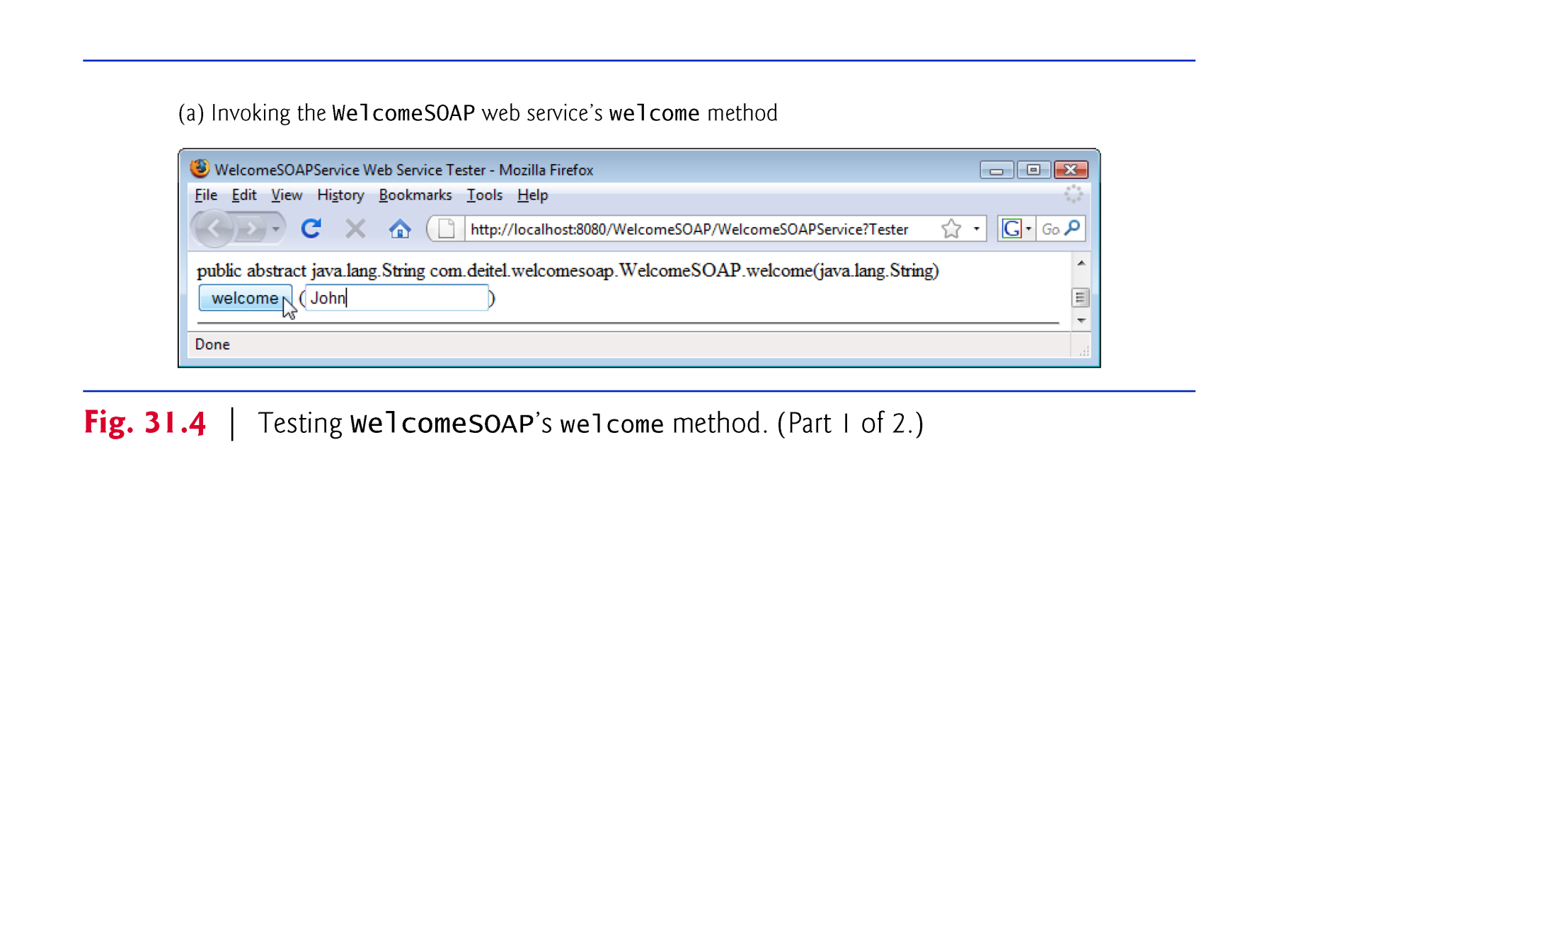

Slide 29
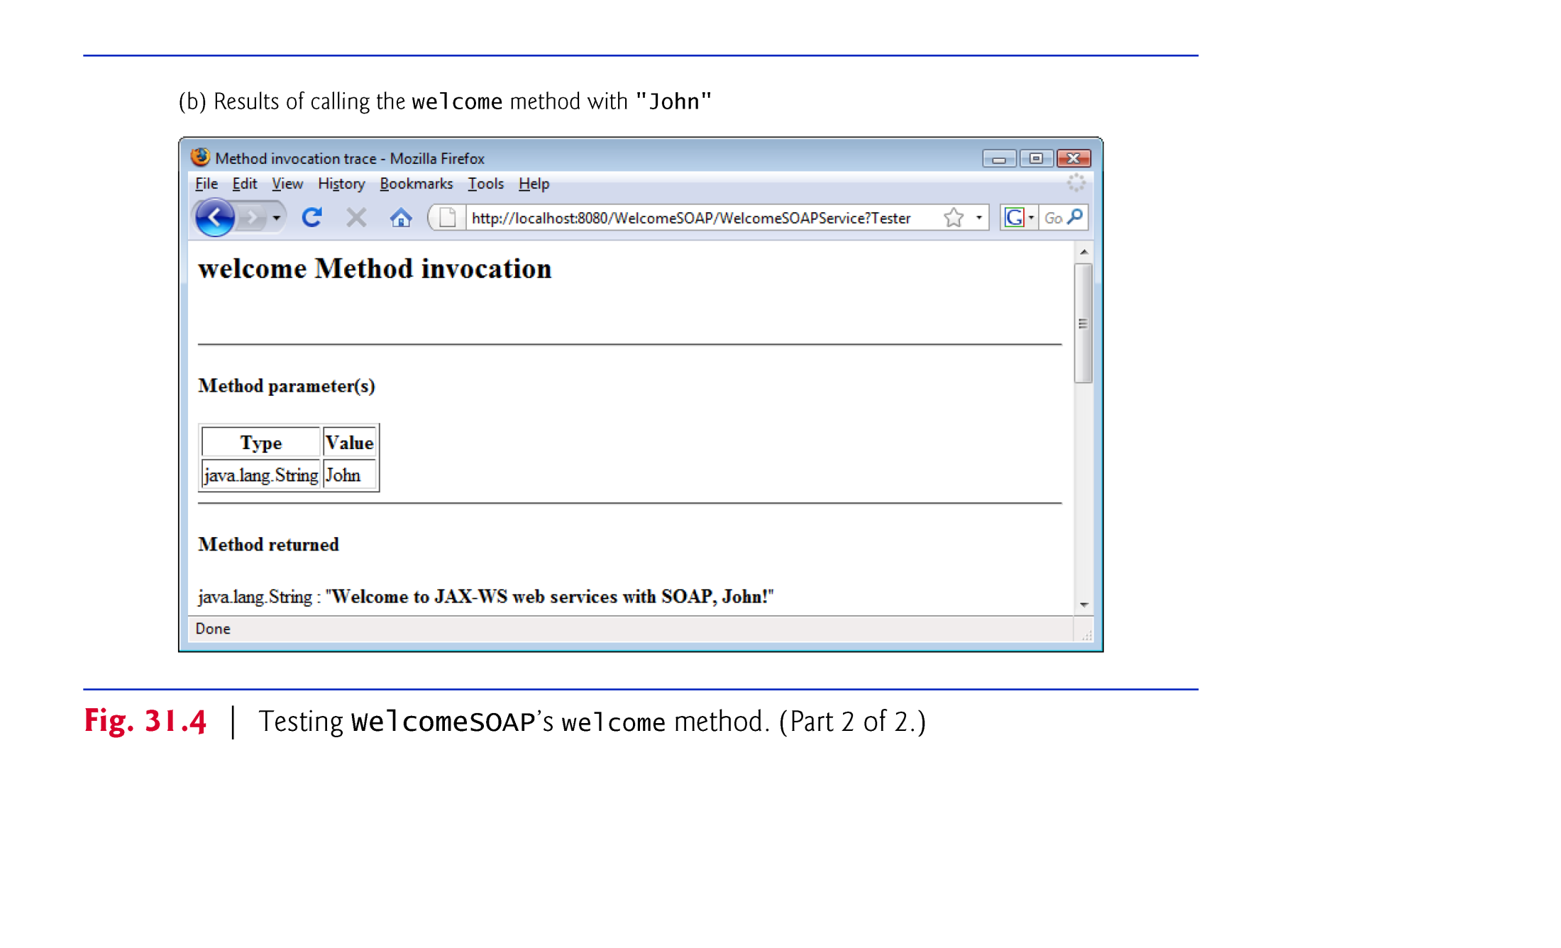

Slide 30
31.6.4 Testing the WelcomeSOAP Web Service with GlassFish Application Server’s Tester Web Page (cont.)
If your computer is connected to a network and allows HTTP requests, then you can test the web service from another computer on the network by replacing localhost with the other computer’s hostname or IP address.
Windows XP and Windows Vista Users
For security reasons, computers running Windows XP or Windows Vista do not allow HTTP requests from other computers by default, so you must explicitly allow such connection in Windows Firewall.

Slide 31
31.6.5 Describing a Web Service with the Web Service Description Language (WSDL)
To consume a web service, a client must determine its functionality and how to use it.
Web services normally contain a service description.
Web Service Description Language (WSDL-)—an XML vocabulary that defines the methods a web service makes available and how clients interact with them.
A WSDL document also specifies lower-level information that clients might need, such as the required formats for requests and responses.
WSDL documents help applications determine how to interact with the web services described in the documents.
GlassFish generates a web service’s WSDL dynamically for you.
To view the WSDL for the WelcomeSOAP web service, click the WSDL File link in the Tester web page (Fig. 31.3).

Slide 32
31.6.5 Describing a Web Service with the Web Service Description Language (WSDL) (cont.)
Eventually, you’ll want clients on other computers to use your web service.
Such clients need access to the web service’s WSDL, which they would access with the following URL:
http://host:8080/WelcomeSOAP/WelcomeSOAPService?WSDL
where host is the hostname or IP address of the server that hosts the web service.

Slide 33
31.6.6 Creating a Client to Consume the WelcomeSOAP Web Service
You enable a Java-based client application to consume a web service by adding a web service reference to the client application.
Defines the service endpoint interface class that allows the client to access the web service.
An application that consumes a web service consists of
an object of a service endpoint interface (SEI) class that’s used to interact with the web service
a client application that consumes the web service by invoking methods on the service endpoint interface object
The service endpoint interface object handles the details of passing method arguments to and receiving return values from the web service on the client’s behalf.
Figure 31.5 depicts the interactions among the client code, the SEI object and the web service.

Slide 34
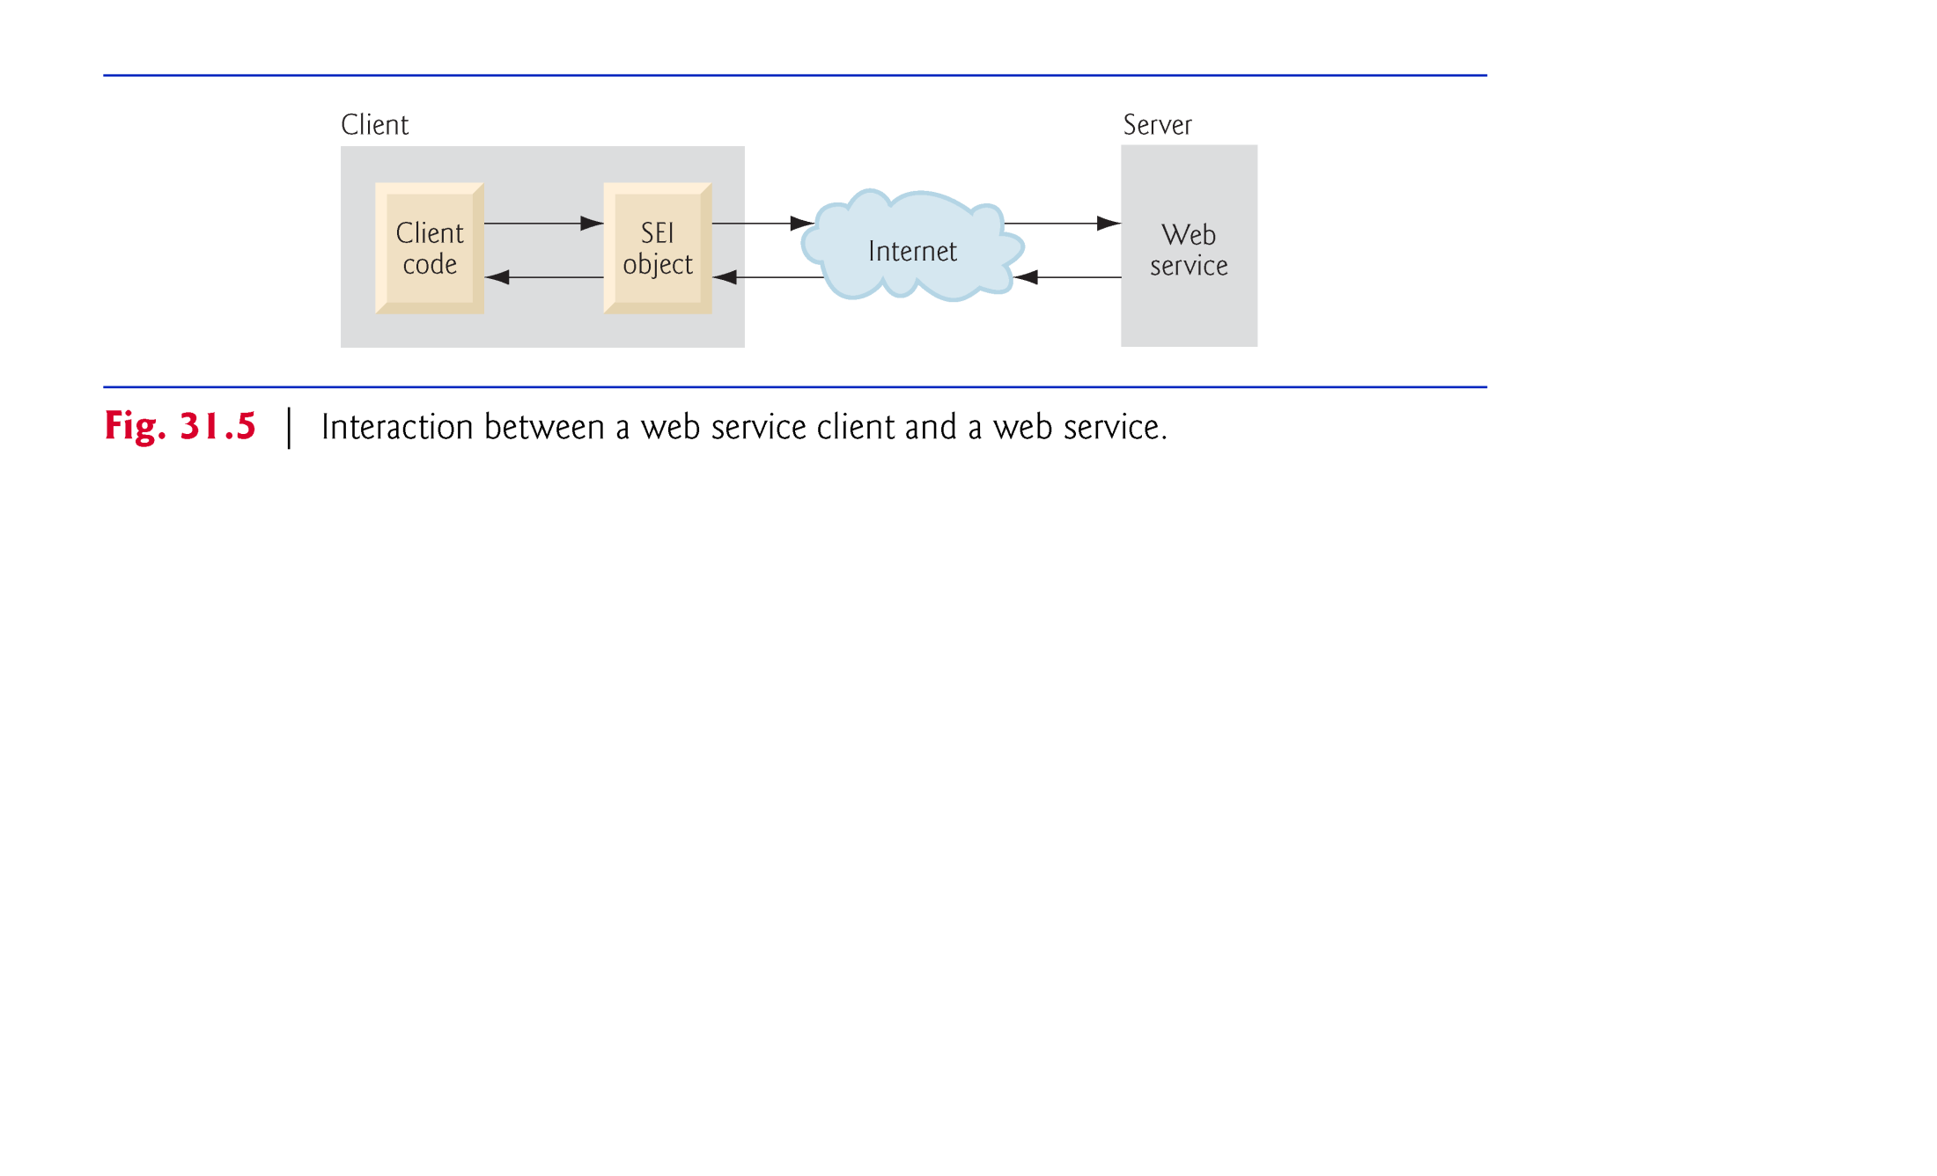

Slide 35
31.6.7 Creating a Client to Consume the WelcomeSOAP Web Service
Requests to and responses from web services created with JAX-WS are typically transmitted via SOAP.
Any client capable of generating and processing SOAP messages can interact with a web service, regardless of the language in which the web service is written.
We now use NetBeans to create a client Java desktop GUI application.
When you add a web service reference, the IDE creates and compiles the client-side artifacts
framework of Java code that supports the client-side service endpoint interface class.
The client then calls methods on an object of the service endpoint interface class, which uses the rest of the artifacts to interact with the web service.

Slide 36
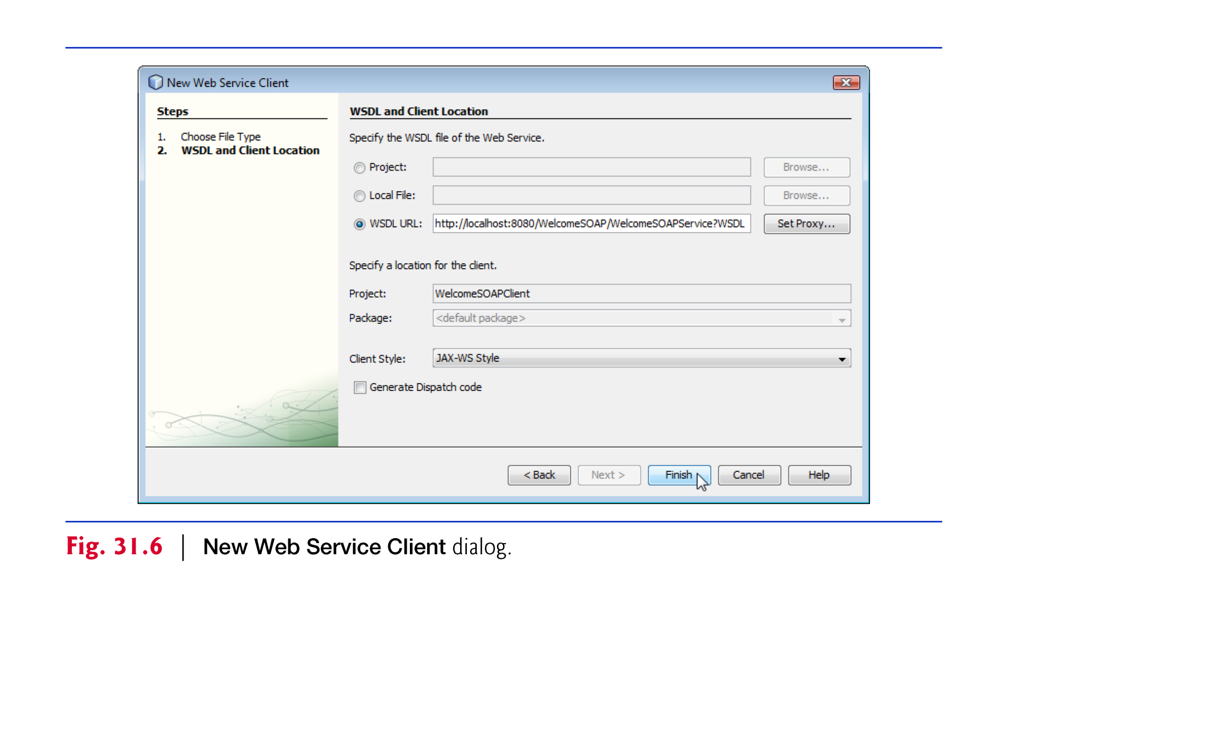

Slide 37
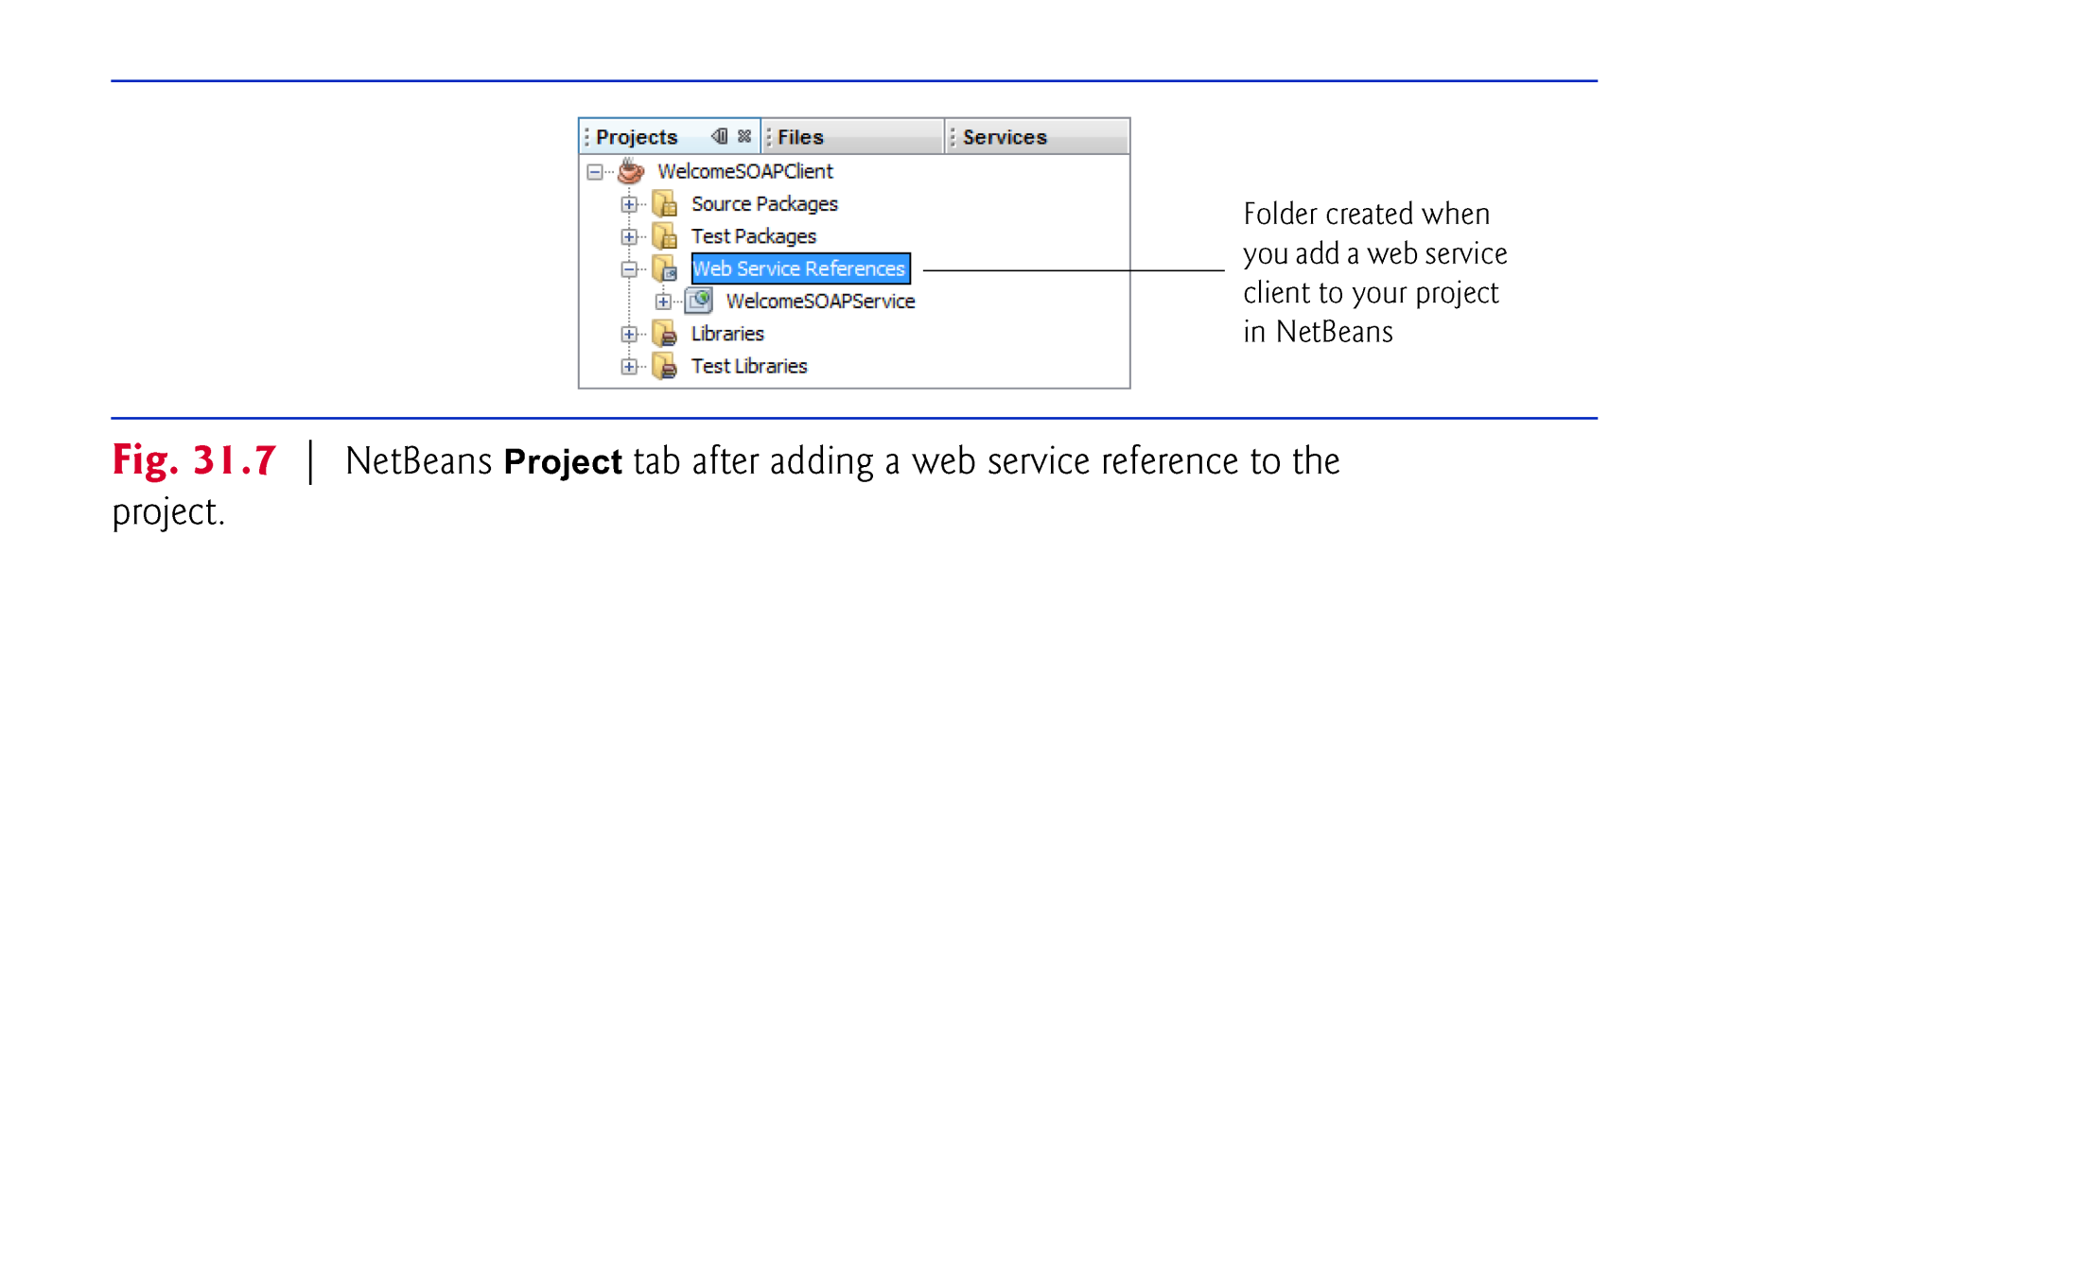

Slide 38
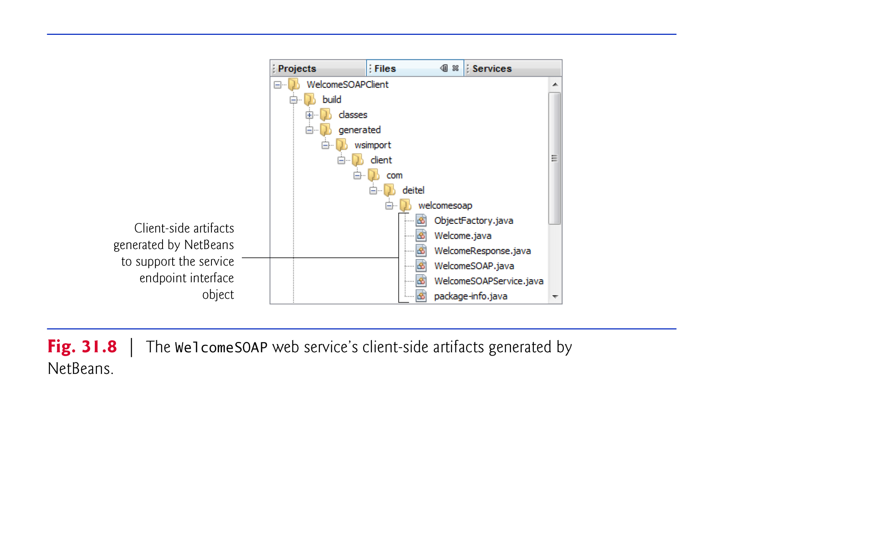

Slide 39
31.6.8 Consuming the WelcomeSOAP Web Service
For this example, we use a GUI application to interact with the WelcomeSOAP web service.

Slide 40
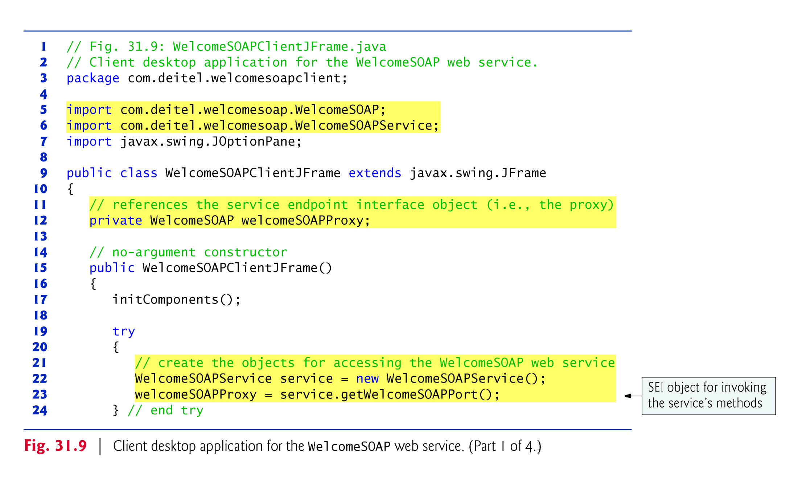

Slide 41
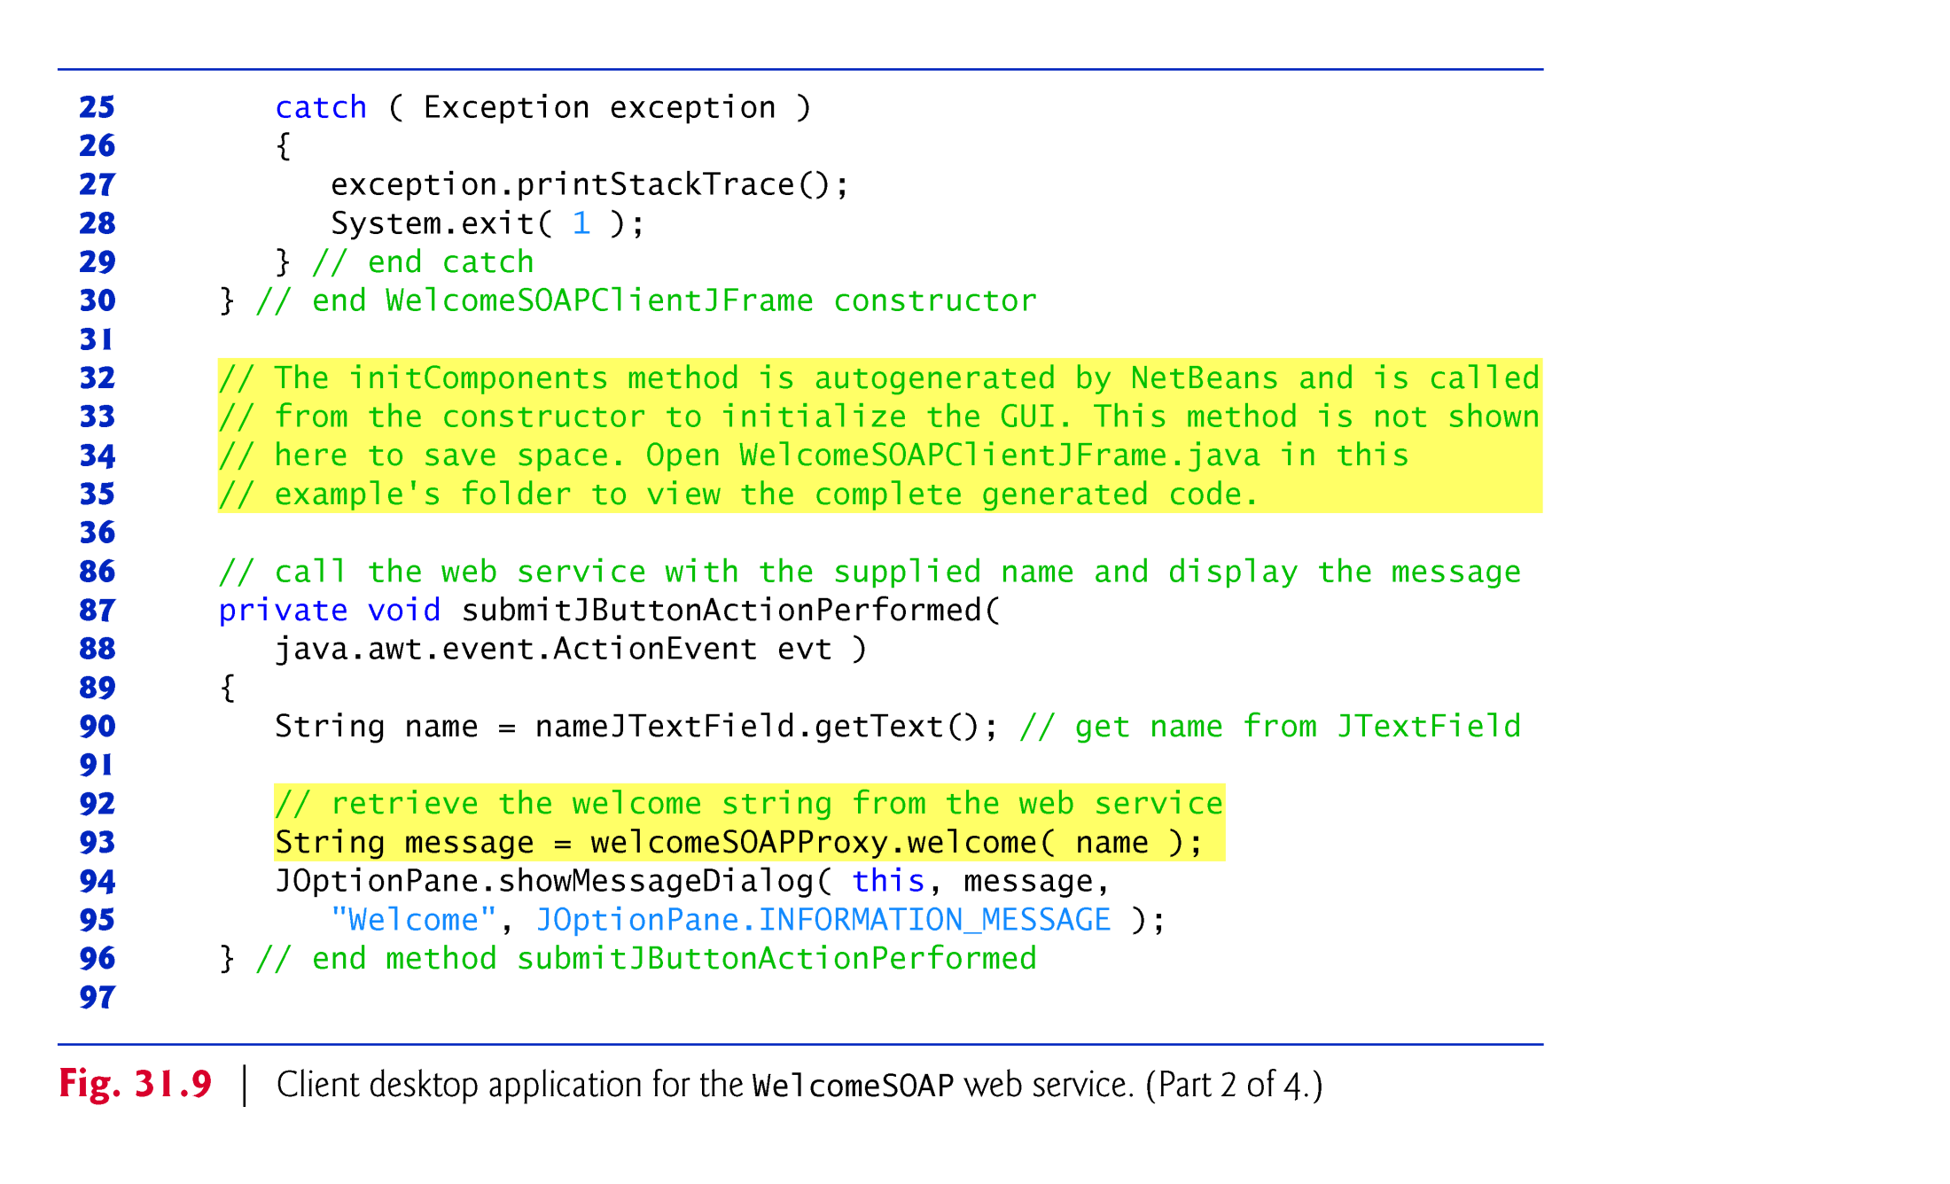

Slide 42
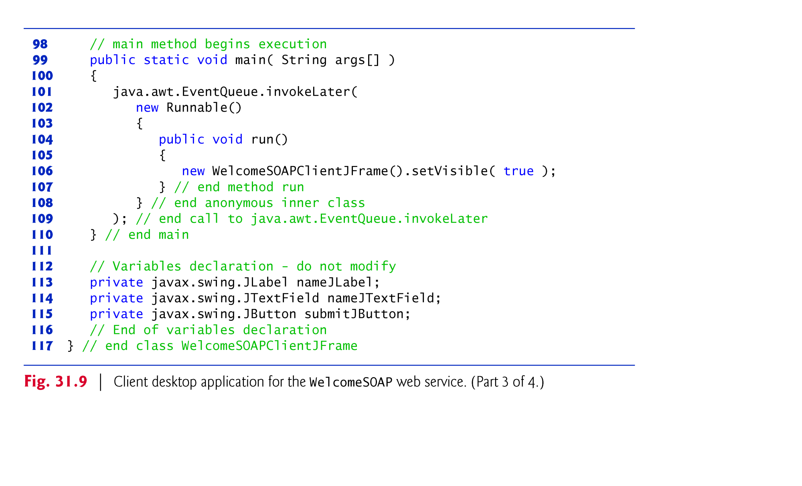

Slide 43
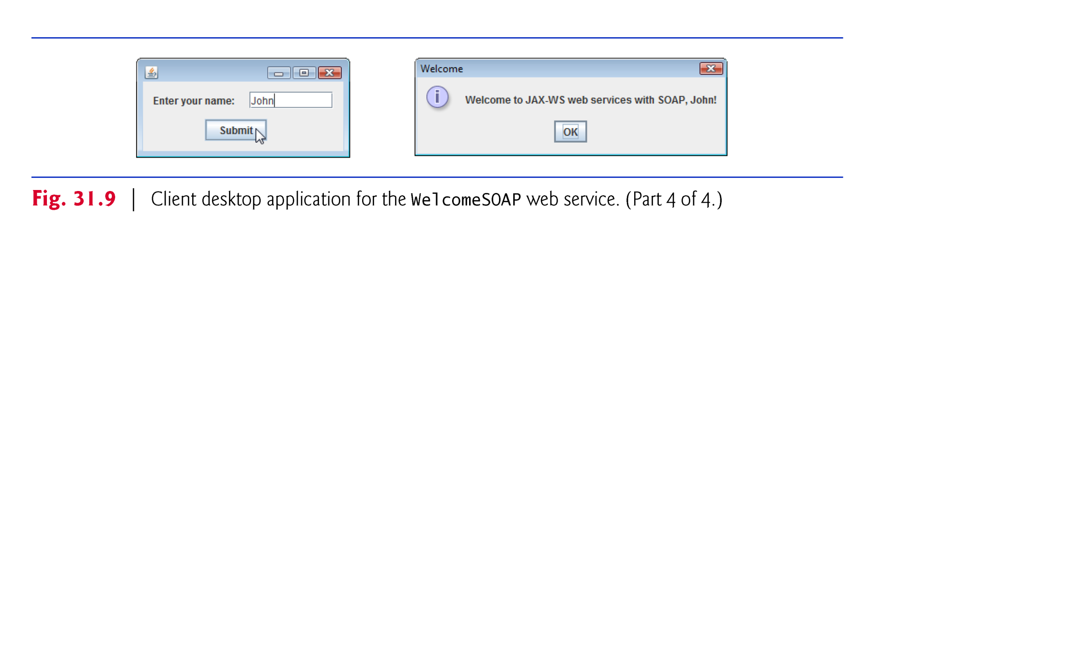

Slide 44
31.7 Publishing and Consuming REST-Based XML Web Services
Now, we access a Java web service using the REST architecture.
We recreate the WelcomeSOAP example to return data in plain XML format.

Slide 45
31.7.1 Creating a REST-Based XML Web Service
The RESTful Web Services plug-in for NetBeans provides templates for creating RESTful web services, including ones that can interact with databases on the client’s behalf.
To create a RESTful web service:
Right-click the WelcomeRESTXML node in the Projects tab, and select New > Other… to display the New File dialog.
Select Web Services under Categories, then select RESTful Web Services from Patterns and click Next >.
Under Select Pattern, ensure Singleton is selected, and click Next >.
For this example, set the Resource Package to com.deitel.welcomerestxml, the Path to welcome and the Class Name to WelcomeRESTXMLResource. Leave the MIME Type and Representation Class set to application/xml and java.lang.String, respectively. The correct configuration is shown in Fig. 31.10.
Click Finish to create the web service.

Slide 46
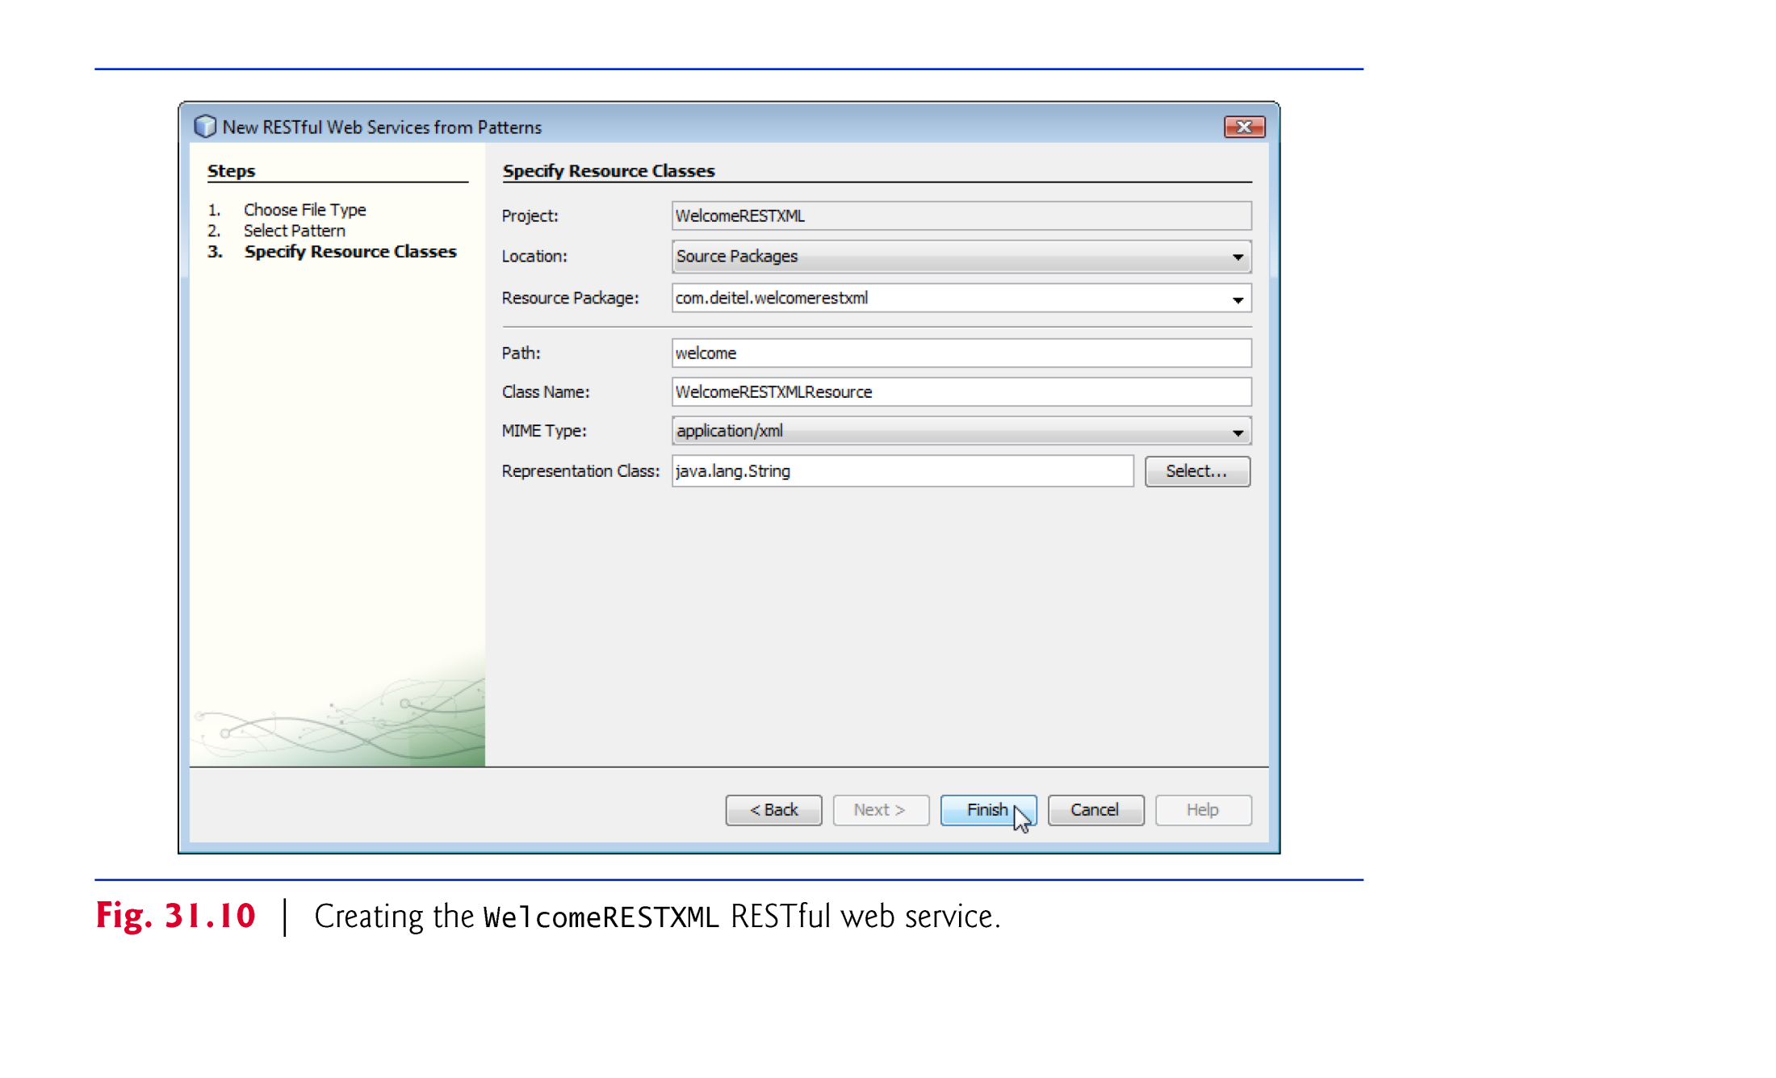

Slide 47
31.7.1 Creating a REST-Based XML Web Service (cont.)
NetBeans generates the class and sets up the proper annotations.
The class is placed in the project’s RESTful Web Services folder.
The code for the completed service is shown in Fig. 31.11.
We removed some of the code generated by NetBeans that was unnecessary for this simple web service.
The @Path annotation on the WelcomeRESTXMLResource class indicates the URI for accessing the web service.
This is appended to the web application project’s URL to invoke the service.

Slide 48
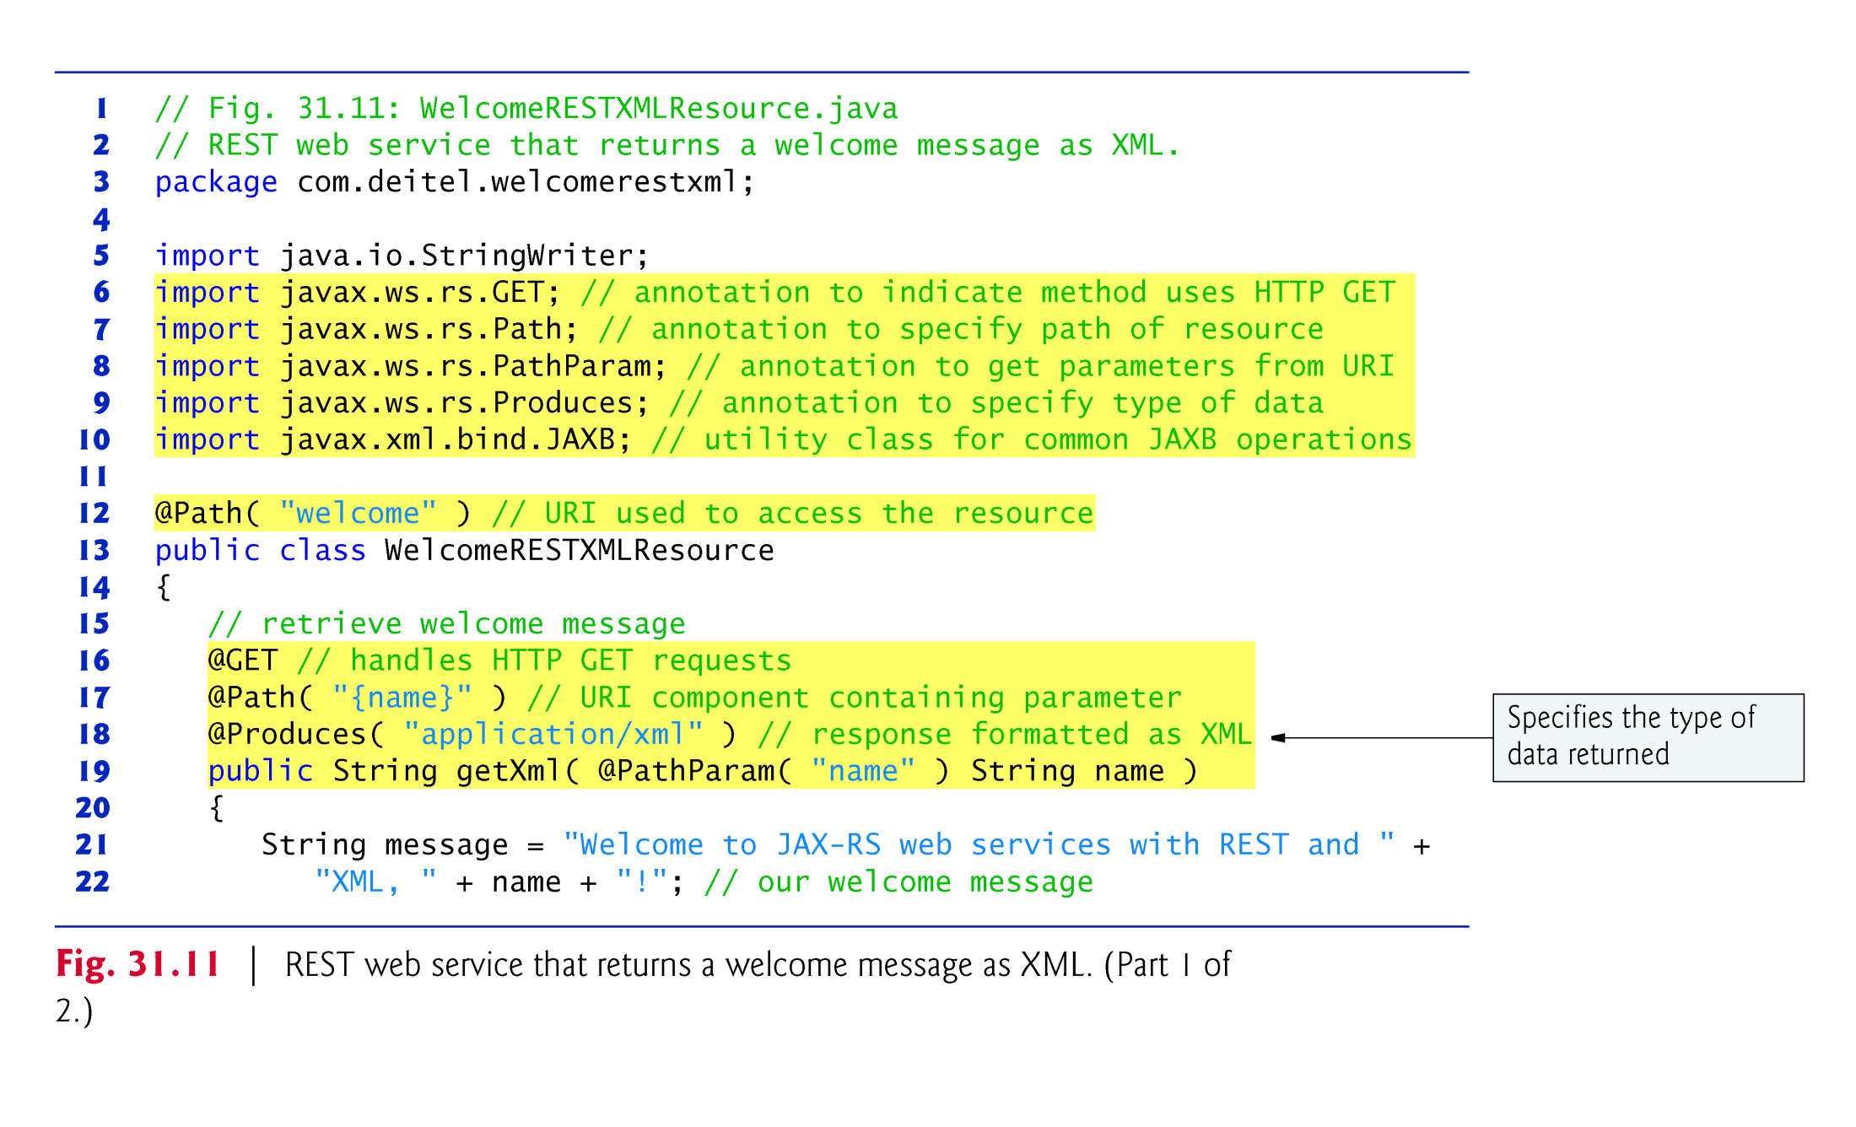

Slide 49
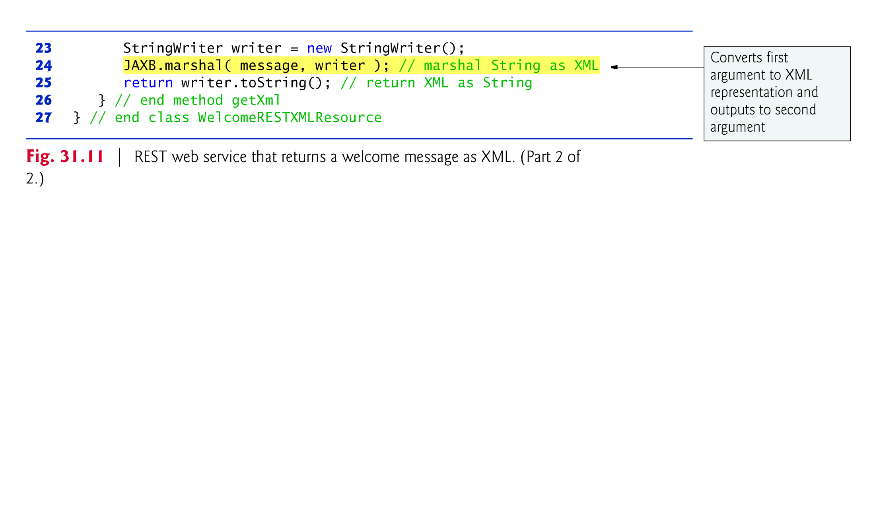

Slide 50
31.7.1 Creating a REST-Based XML Web Service (cont.)
Methods of the class can also use the @Path annotation.
Parts of the path specified in curly braces indicate parameters—they are placeholders for values that are passed to the web service as part of the path.
Arguments in a URL can be used as arguments to a web service method.
To do so, you bind the parameters specified in the @Path specification to parameters of the web service method with the @PathParam annotation.
When the request is received, the server passes the argument(s) in the URL to the appropriate parameter(s) in the web service method.

Slide 51
31.7.1 Creating a REST-Based XML Web Service (cont.)
The @GET annotation denotes that this method is accessed via an HTTP GET request.
The @Produces annotation denotes the content type returned to the client.
It is possible to have multiple methods with the same HTTP method and path but different @Produces annotations, and JAX-RS will call the method matching the content type requested by the client.
The @Consumes annotation restricts the content type that the web service will accept from a client.

Slide 52
31.7.1 Creating a REST-Based XML Web Service (cont.)
JAXB class from package javax.xml.bind.
JAXB (Java Architecture for XML Binding) is a set of classes for converting POJOs to and from XML.
JAXB class contains easy-to-use wrappers for common operations.
JAXB static method marshal converts its argument to XML format.

Slide 53
31.7.1 Creating a REST-Based XML Web Service (cont.)
GlassFish does not provide a testing facility for RESTful services, but NetBeans automatically generates a test page that can be accessed by right clicking the WelcomeRESTXML node in the Projects tab and selecting Test RESTful Web Services.
On the test page (Fig. 31.12), expand the welcome element in the left column and select {name}.
The right side of the page displays a form that allows you to choose the MIME type of the data (application/xml by default) and lets you enter the name parameter’s value.
Click the Test button to invoke the web service and display the returned XML

Slide 54
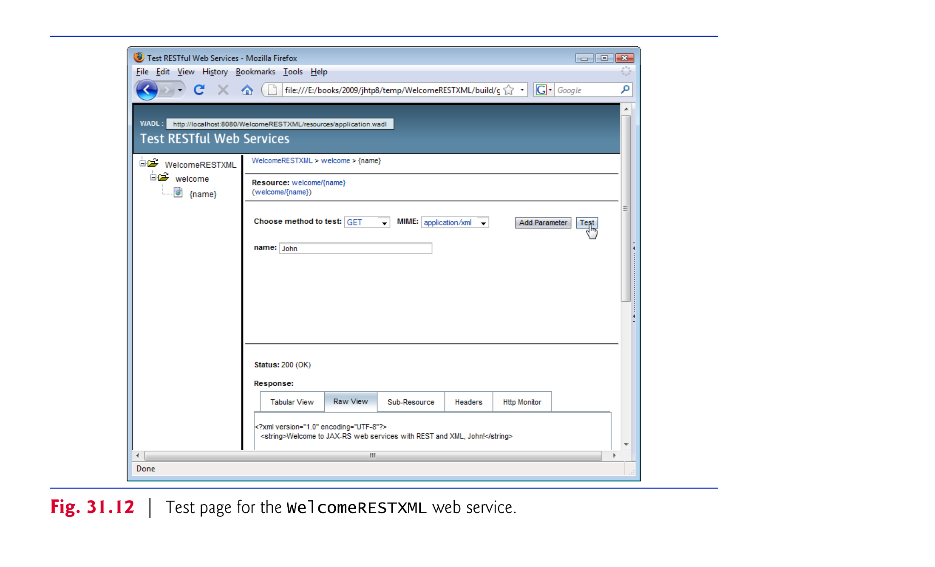

Slide 55
31.7.1 Creating a REST-Based XML Web Service (cont.)
The test page shows several tabs containing the results and various other information.
The Raw Text tab shows the actual XML response.
The Headers tab shows the HTTP headers returned by the server.
The Http Monitor tab shows a log of the HTTP transactions that took place to complete the request and response.
The test page provides its functionality by reading a WADL file from the server.
WADL (Web Application Description Language) has similar design goals to WSDL, but describes RESTful services instead of SOAP services.

Slide 56
31.7.2 Consuming a REST-Based XML Web Service
RESTful web services do not require web service references.
As in the RESTful XML web service, we use the JAXB library.
JAXB static method unmarshal takes as arguments a file name or URL as a String, and a Class<T> object indicating the Java class to which the XML will be converted.

Slide 57
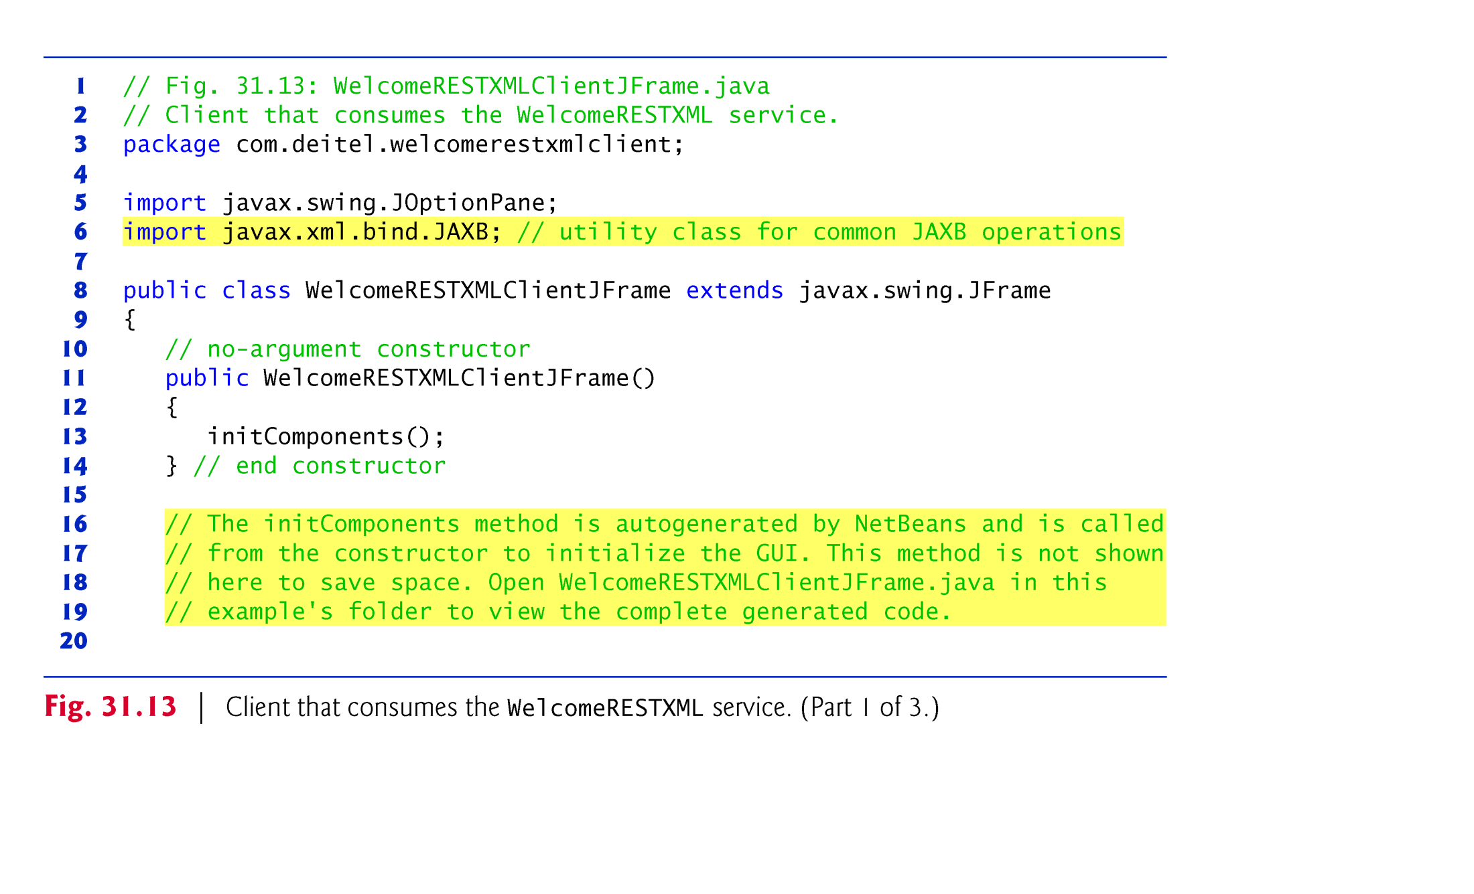

Slide 58
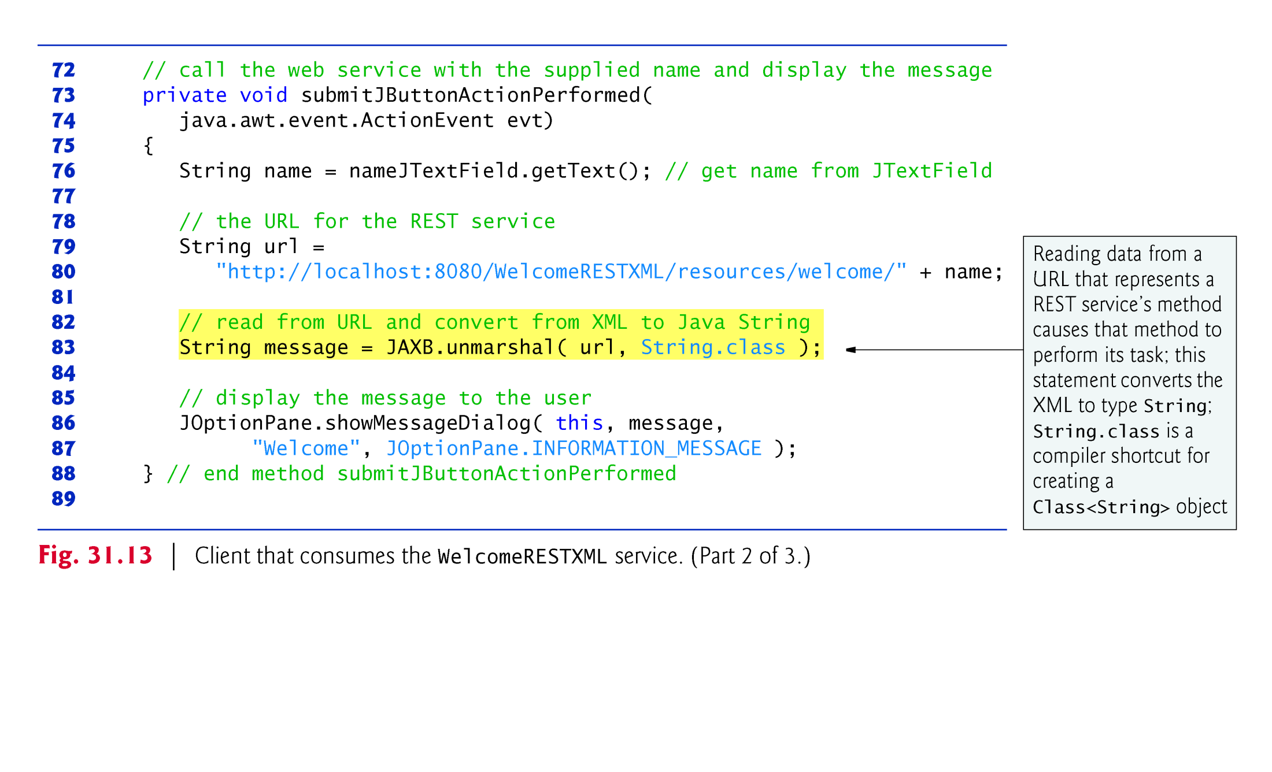

Slide 59
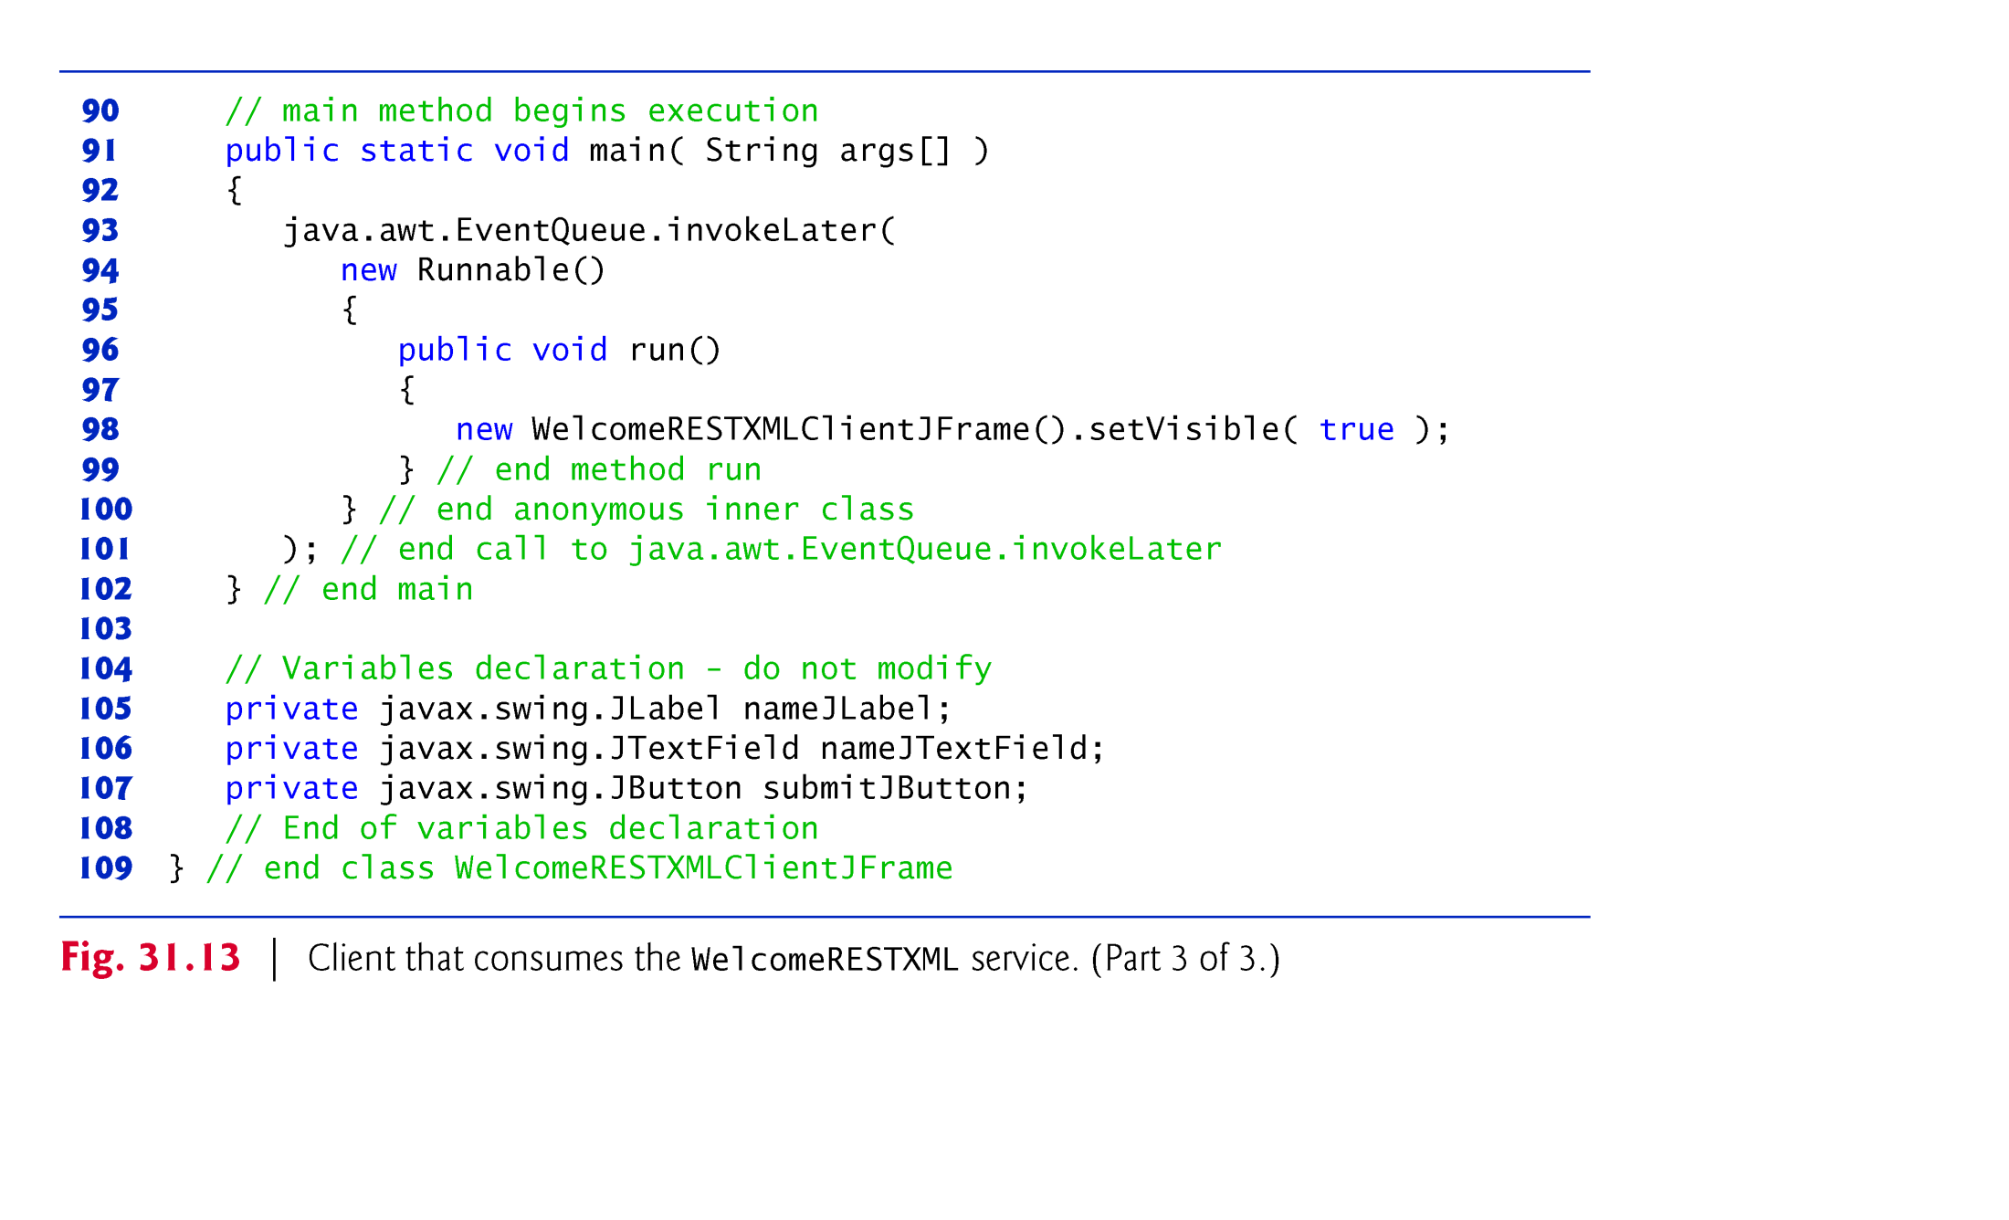

Slide 60
31.8 Publishing and Consuming REST-Based JSON Web Services
XML was designed primarily as a document interchange format.
JSON is designed as a data exchange format.
Data structures in most programming languages do not map directly to XML constructs.
JSON is a subset of the JavaScript programming language, and its components—objects, arrays, strings, numbers—can be easily mapped to constructs in Java and other programming languages.
There are many open-source JSON libraries for Java and other languages; you can find a list of them at json.org.
We use the Gson library from code.google.com/p/google-gson/.

Slide 61
31.8.1 Creating a REST-Based JSON Web Service
You must download the Gson library’s JAR file, then add it to the project as a library.
To do so, right click your project’s Libraries folder, select Add JAR/Folder… locate the downloaded Gson JAR file and click Open.
Note that the argument to the @Produces attribute is "application/json".
JSON does not permit strings or numbers to stand on their own—they must be encapsulated in a composite data type.
So, we created class TextMessage to encapsulate the String representing the message.
Gson (from package com.google.gson.Gson) method toJson converts an object into its JSON String representation.
RESTful services returning JSON can be tested in the same way as those returning XML.

Slide 62
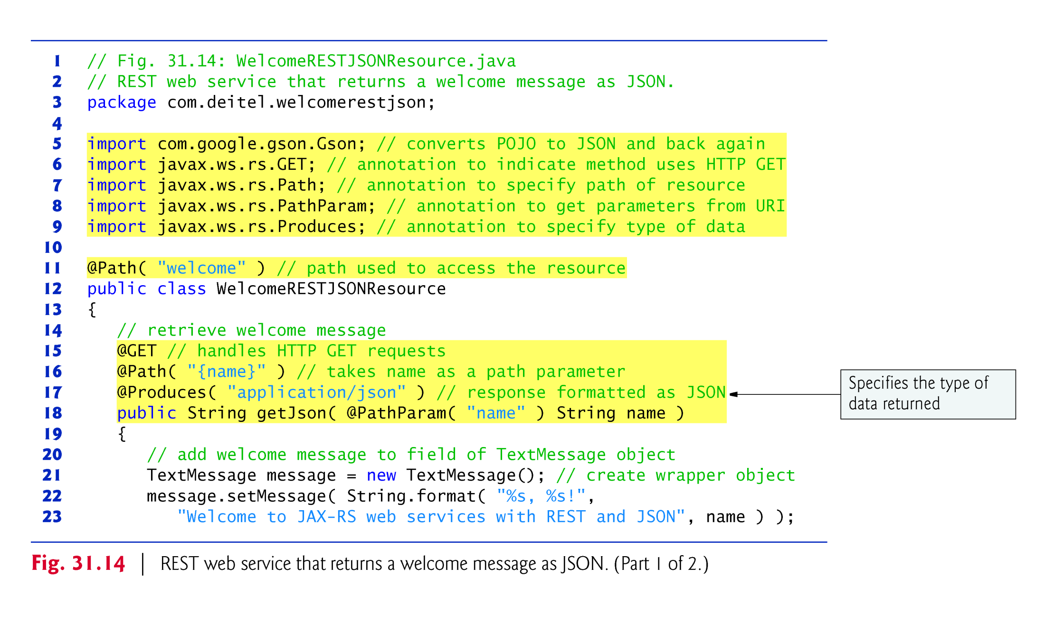

Slide 63
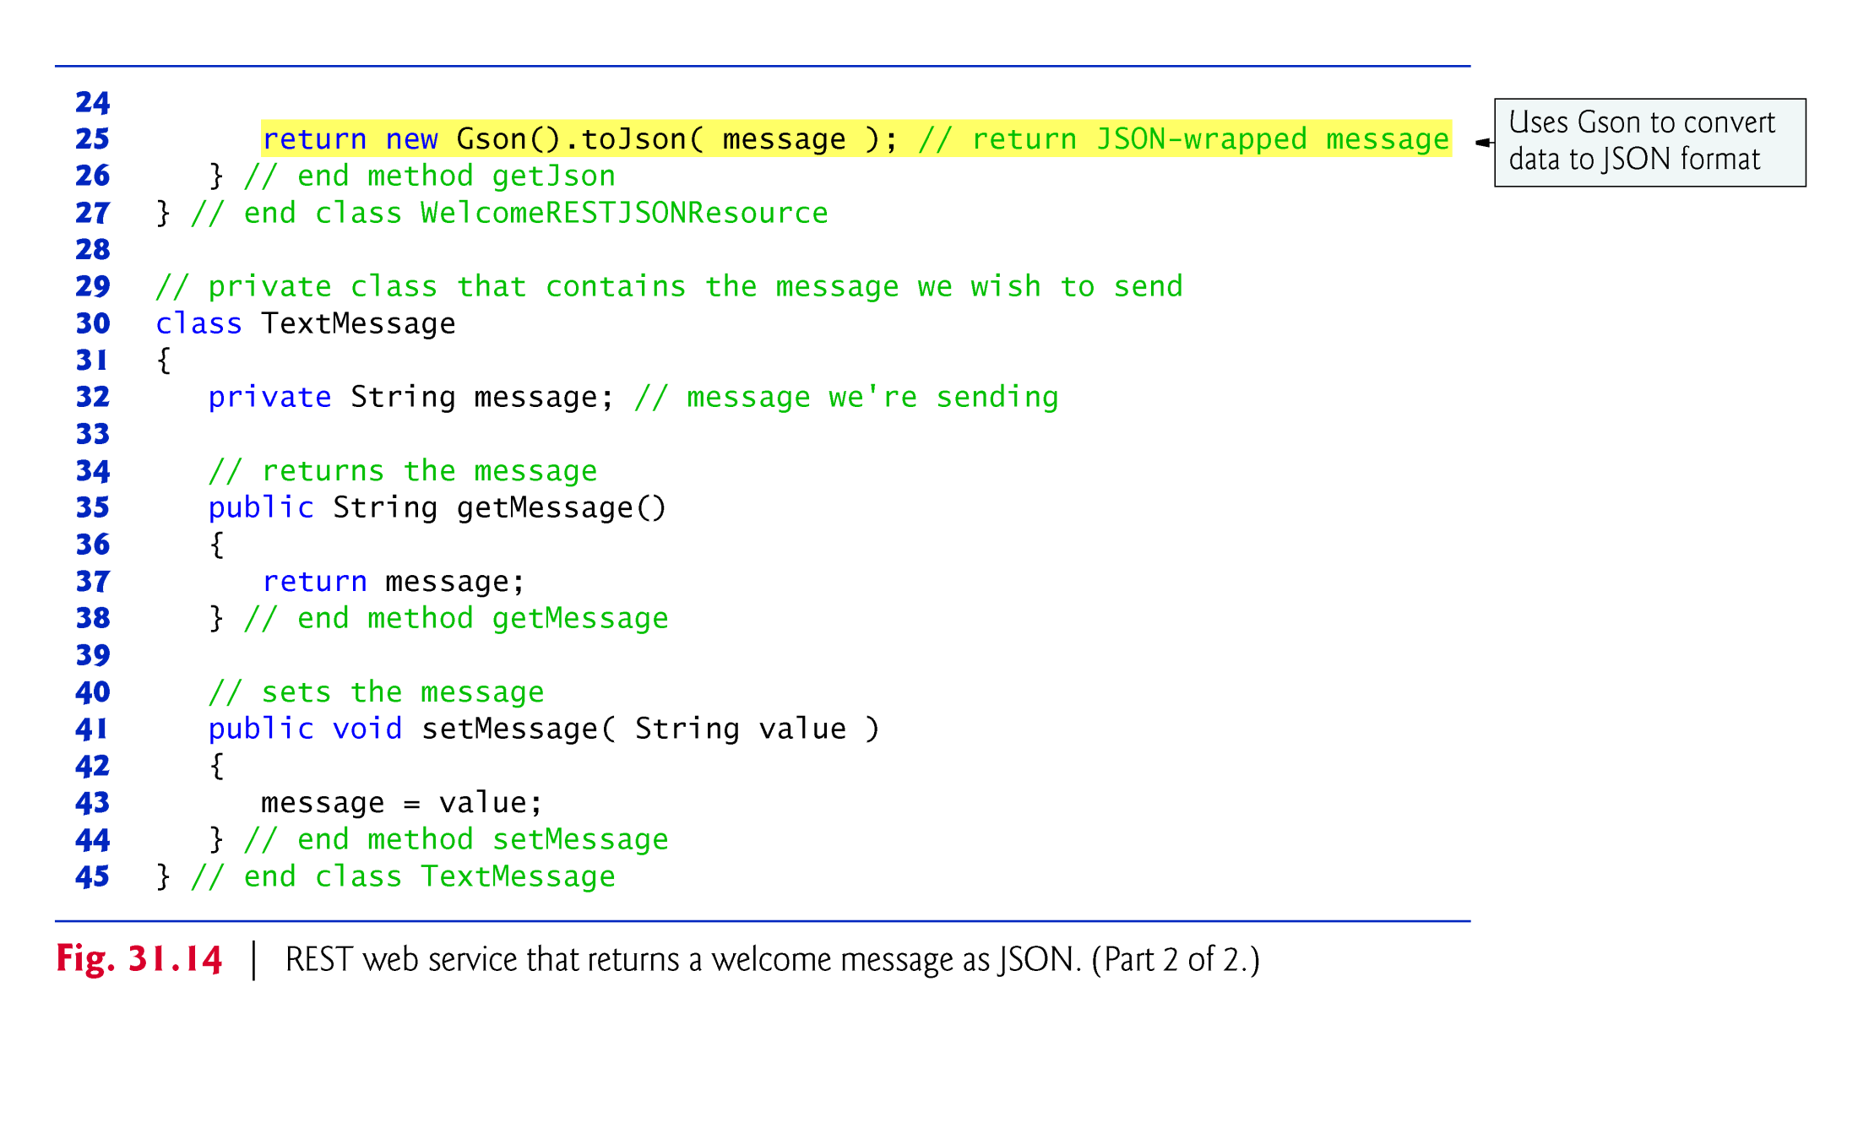

Slide 64
31.8.2 Consuming a REST-Based JSON Web Service
URL method openStream invokes the web service and obtains an InputStream from which the client can read the response.
We wrap the InputStream in an InputStreamReader so it can be passed as the first argument to the Gson class’s fromJson method.
The method we use takes as arguments a Reader from which to read a JSON String and a Class<T> object indicating the Java class to which the JSON String will be converted.

Slide 65
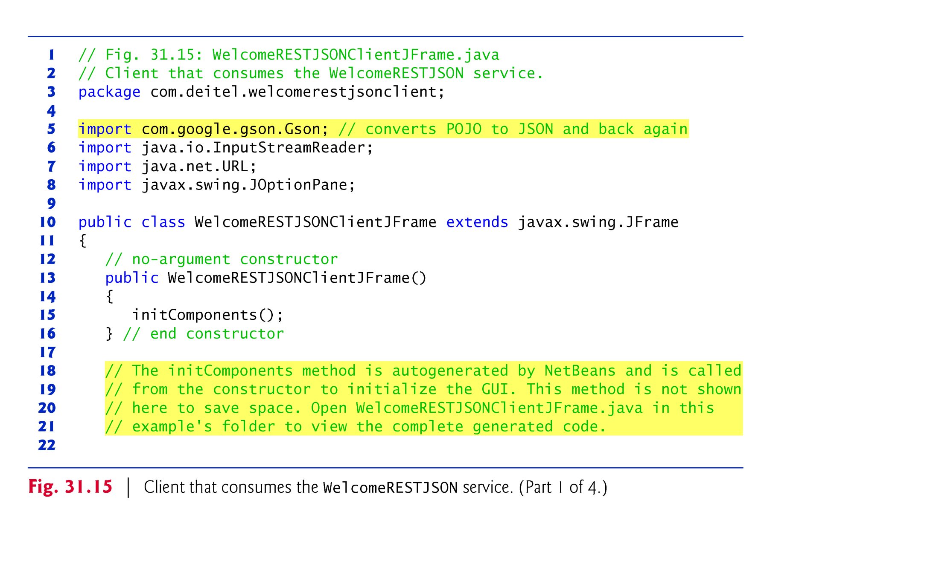

Slide 66
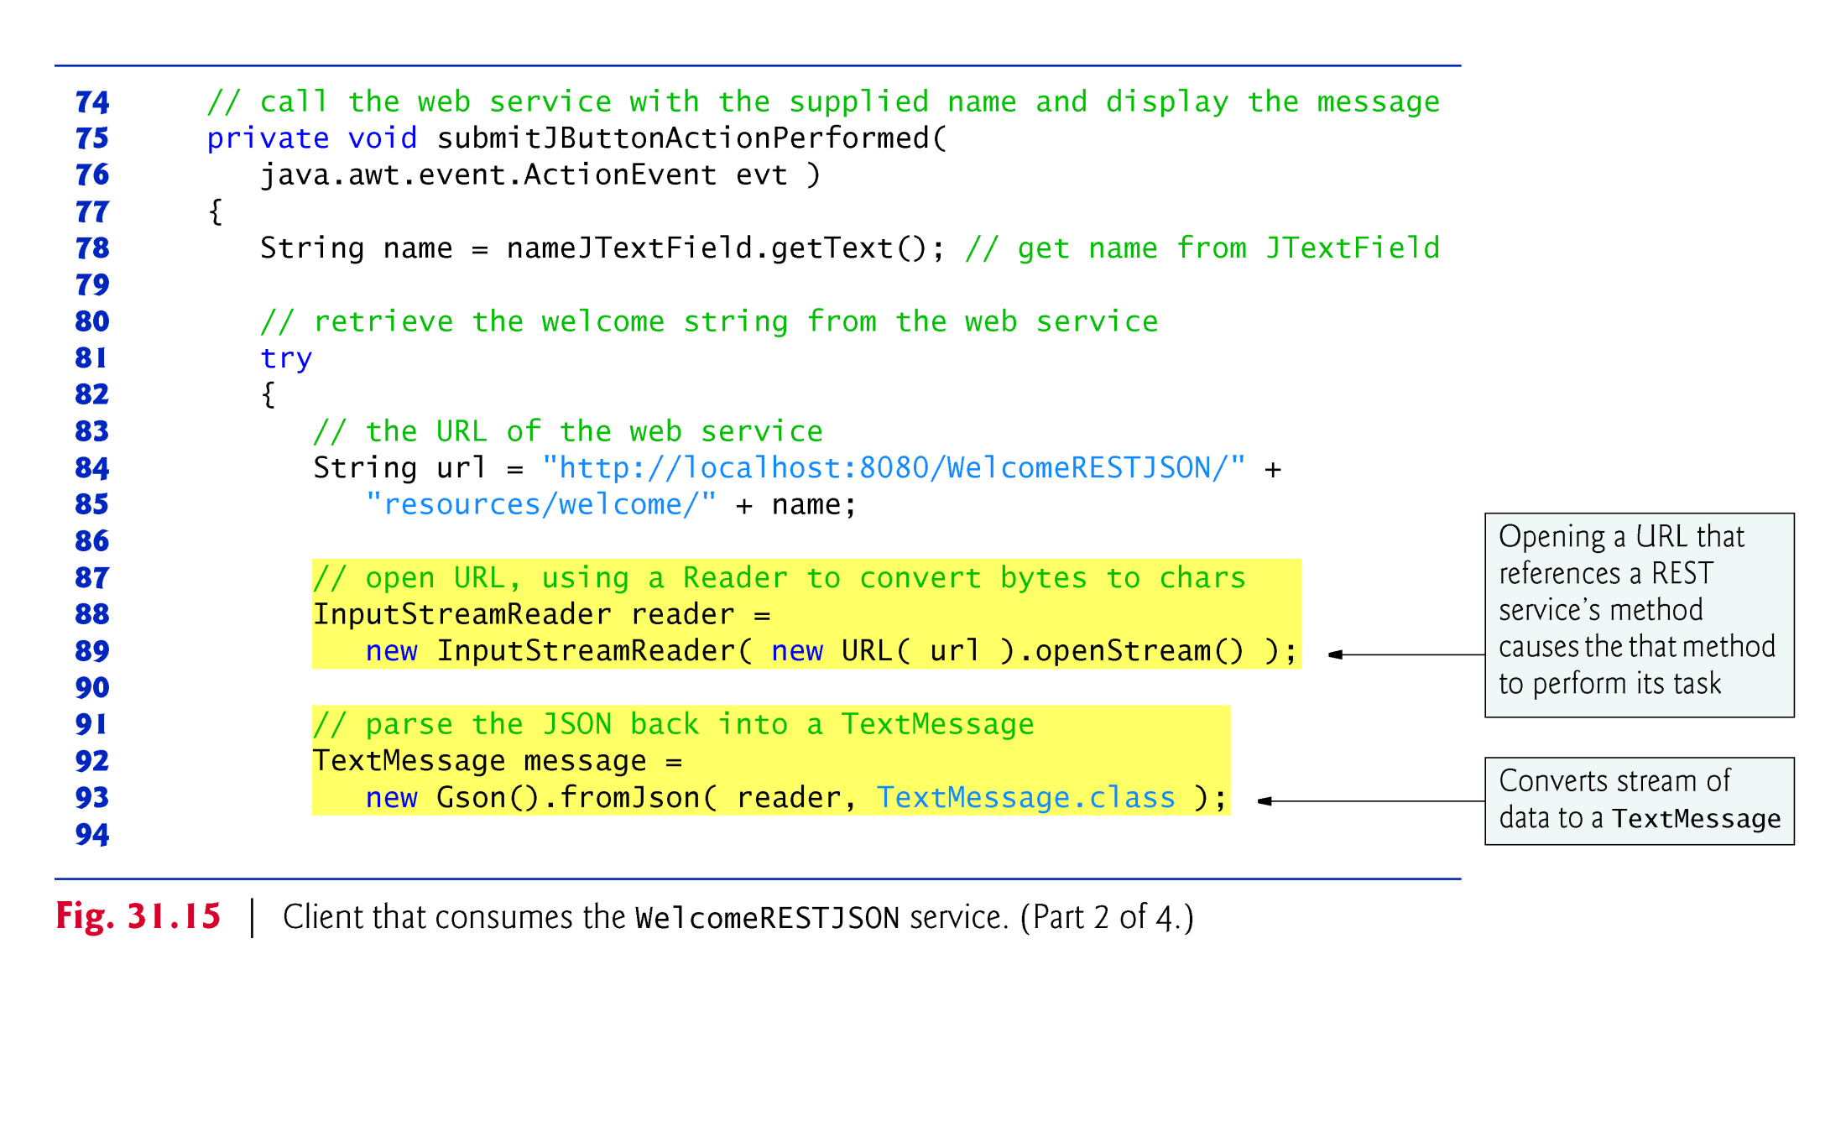

Slide 67
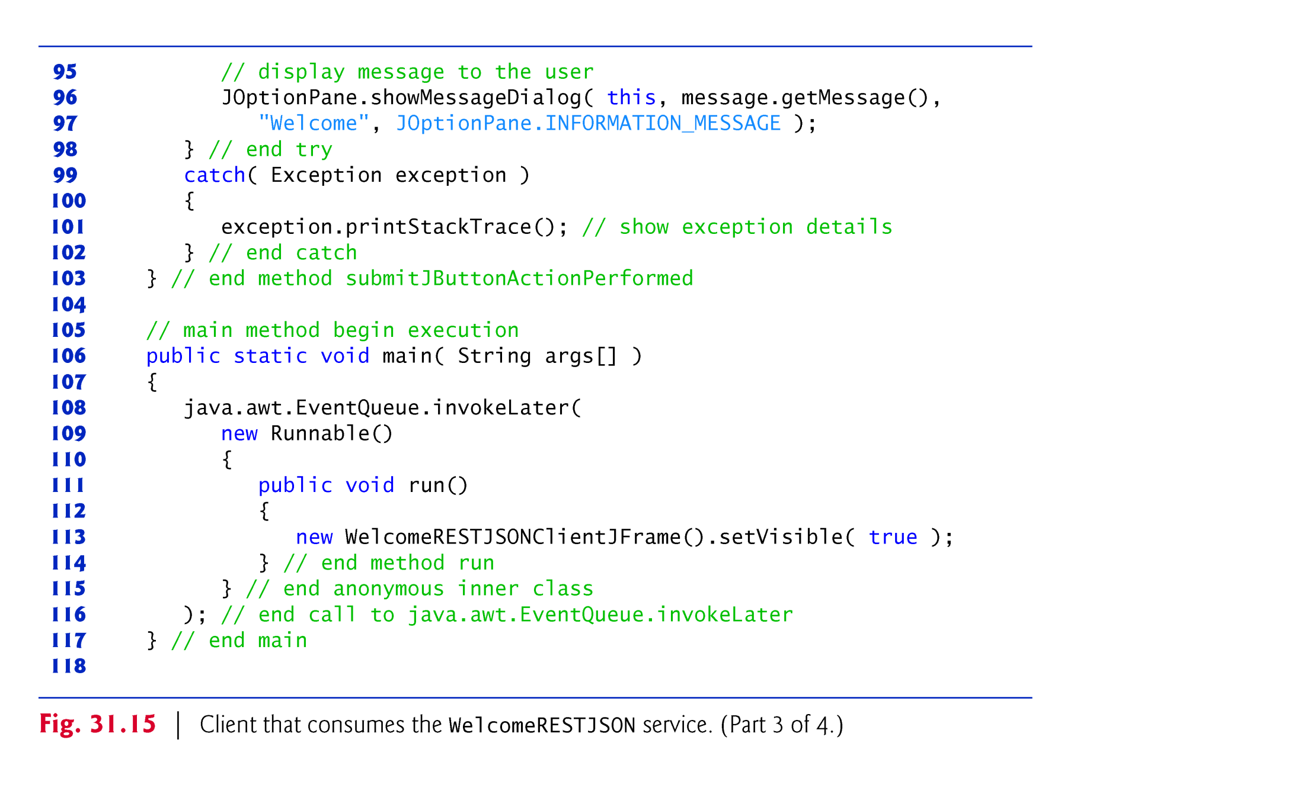

Slide 68
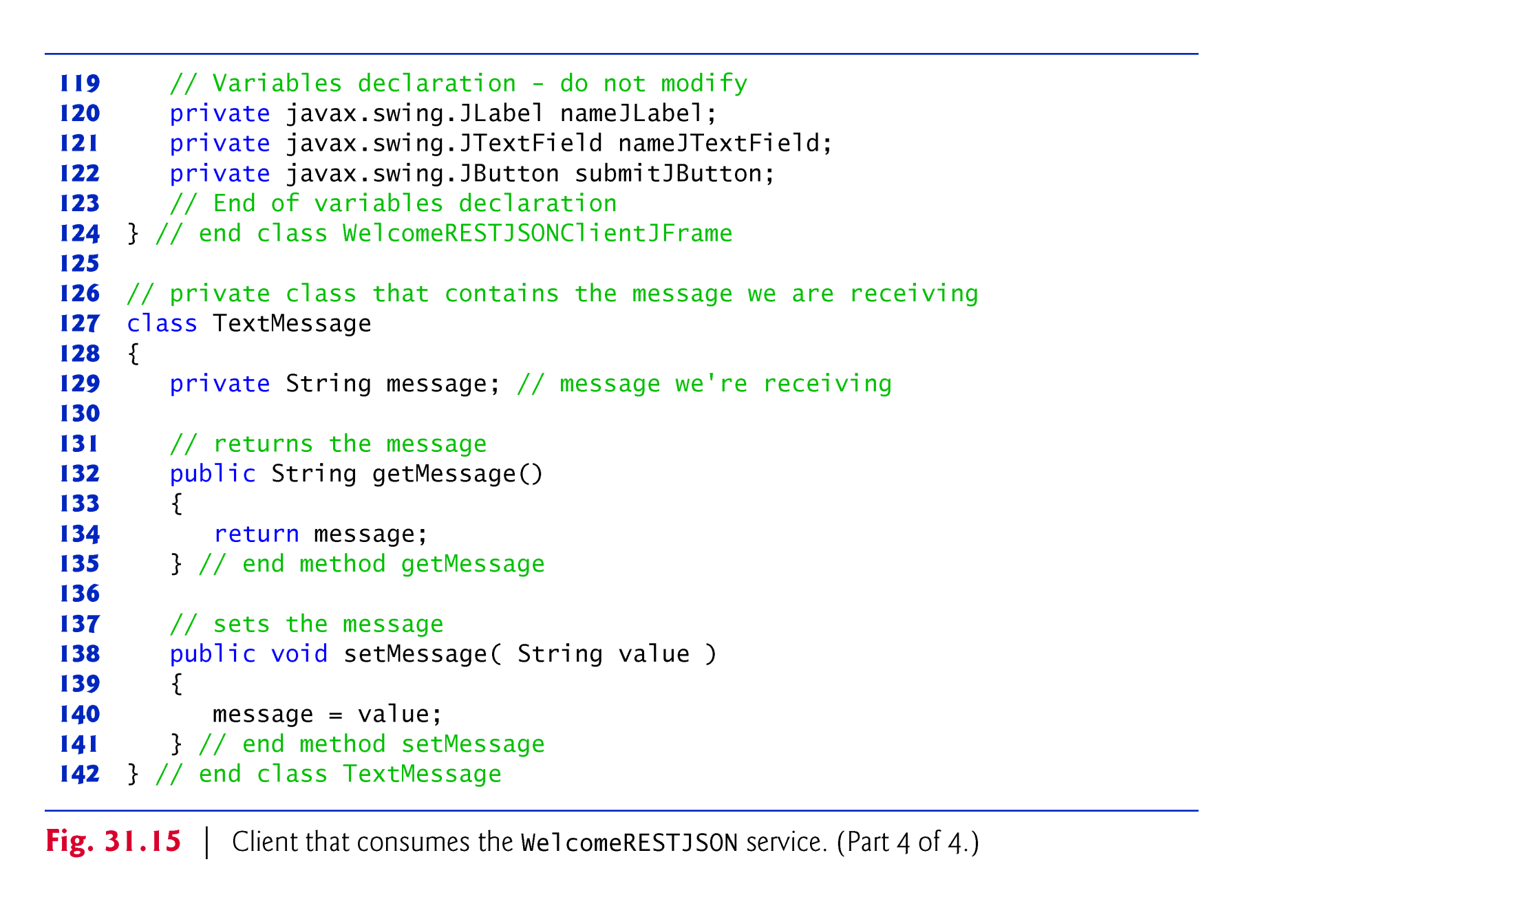

Slide 69
31.9 Session Tracking in a SOAP-Based Web Service
Section 29.7 described the advantages of using session tracking to maintain client-state information so you can personalize the users’ browsing experiences.
Now we’ll incorporate session tracking into a web service.
Storing session information also enables a web service to distinguish between clients.

Slide 70
31.9.1 Creating a Blackjack Web Service
Our next example is a web service that assists you in developing a blackjack card game.
The Blackjack web service (Fig. 31.16) provides web methods to shuffle a deck of cards, deal a card from the deck and evaluate a hand of cards.
The web service (Fig. 31.16) stores each card as a String consisting of a number, 1–13, representing the card’s face (ace through king, respectively), followed by a space and a digit, 0–3, representing the card’s suit (hearts, diamonds, clubs or spades, respectively).
For example, the jack of clubs is represented as "11 2" and the two of hearts as "2 0".
To create and deploy this web service, follow the steps that we presented in Sections 31.6.2–31.6.3 for the WelcomeSOAP service.

Slide 71
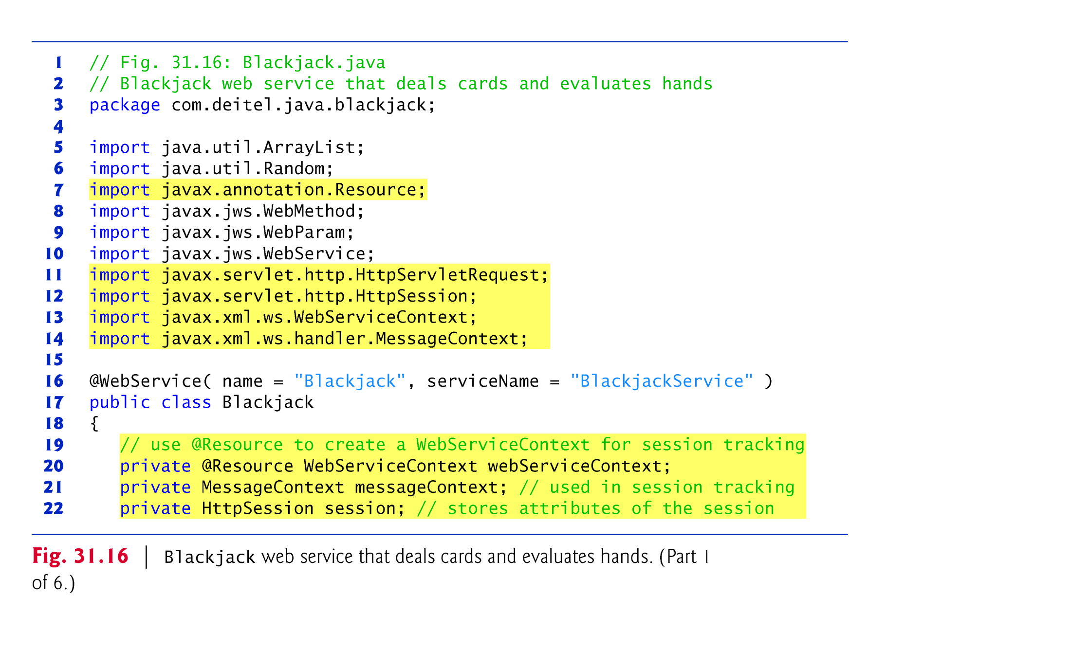

Slide 72
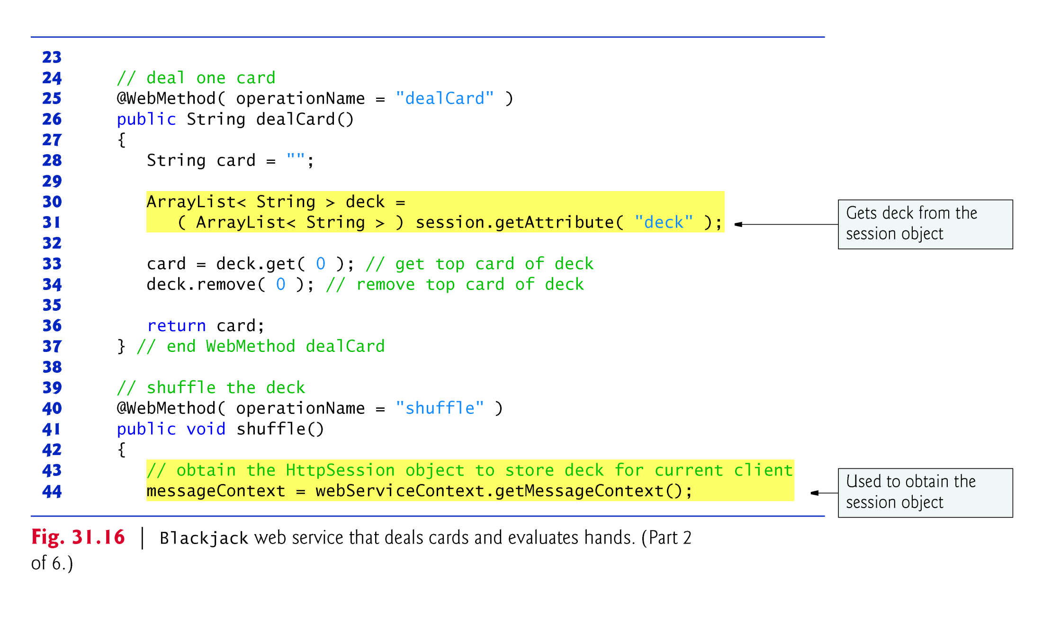

Slide 73
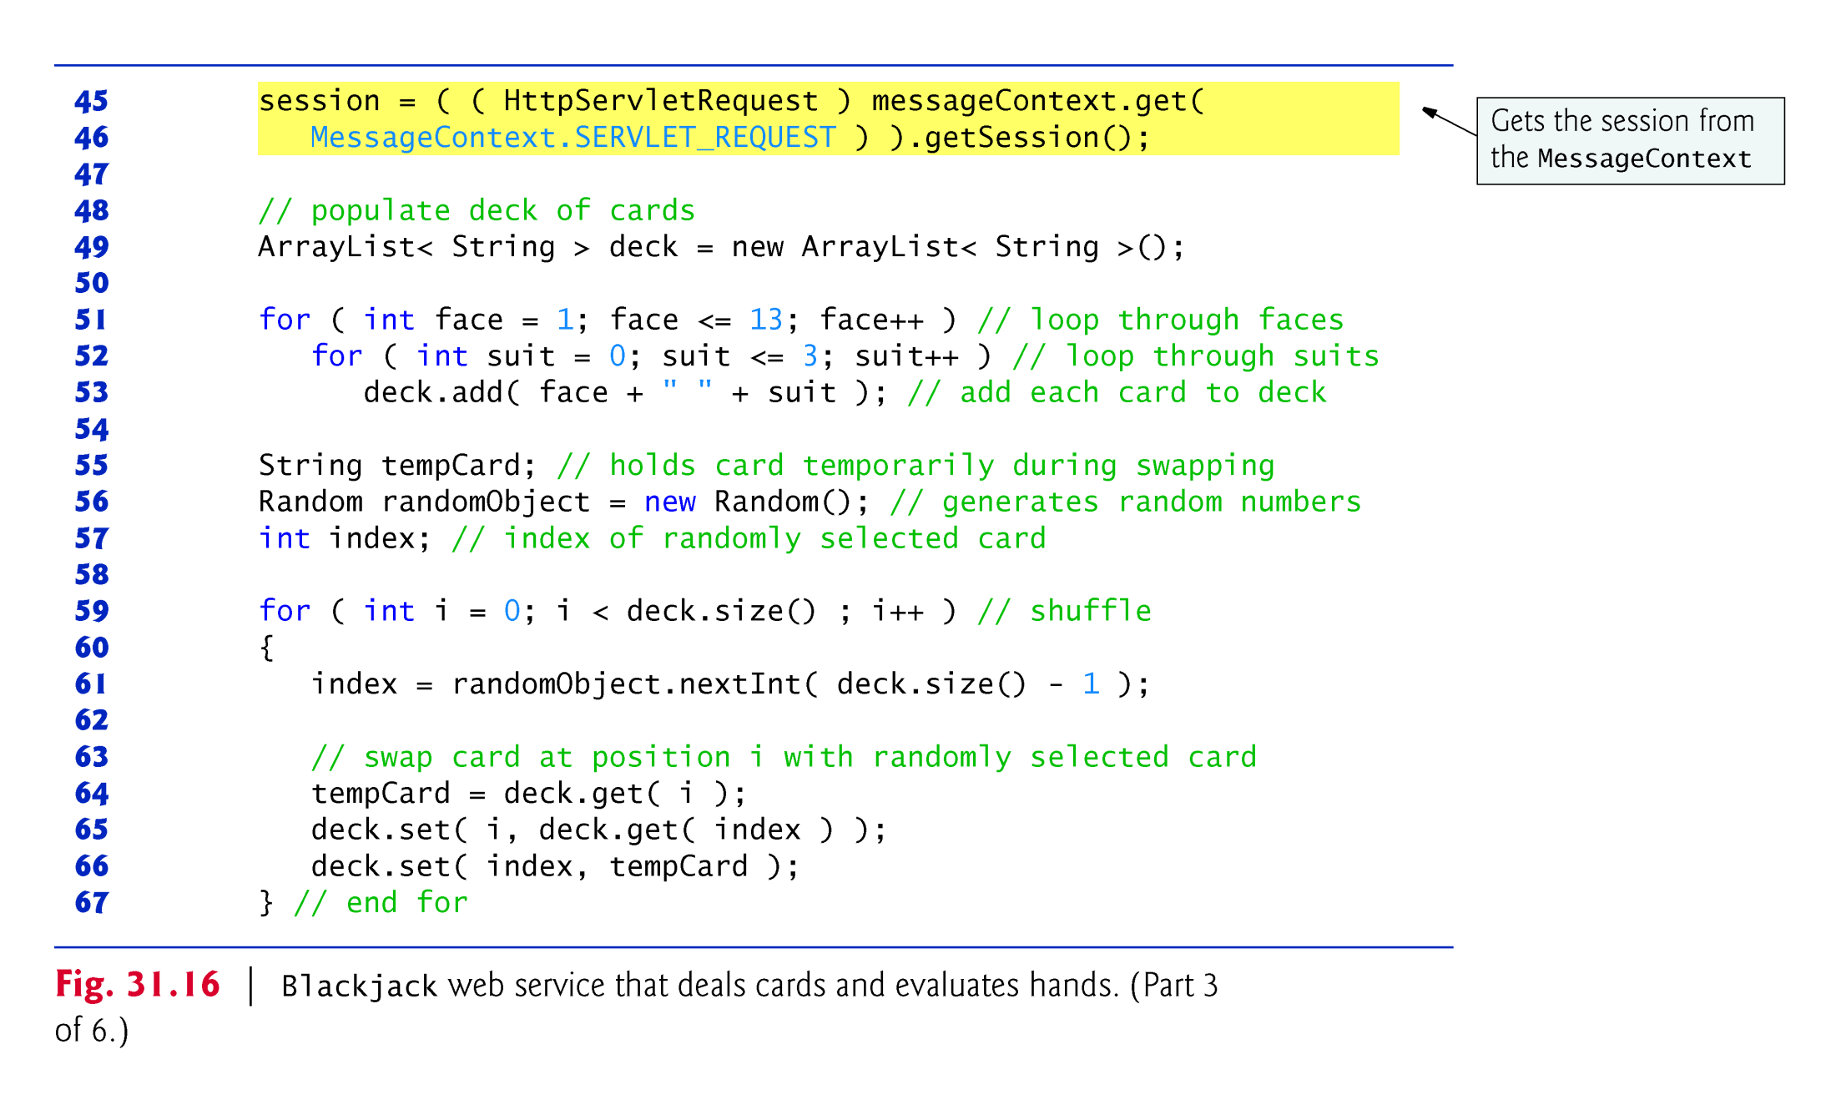

Slide 74
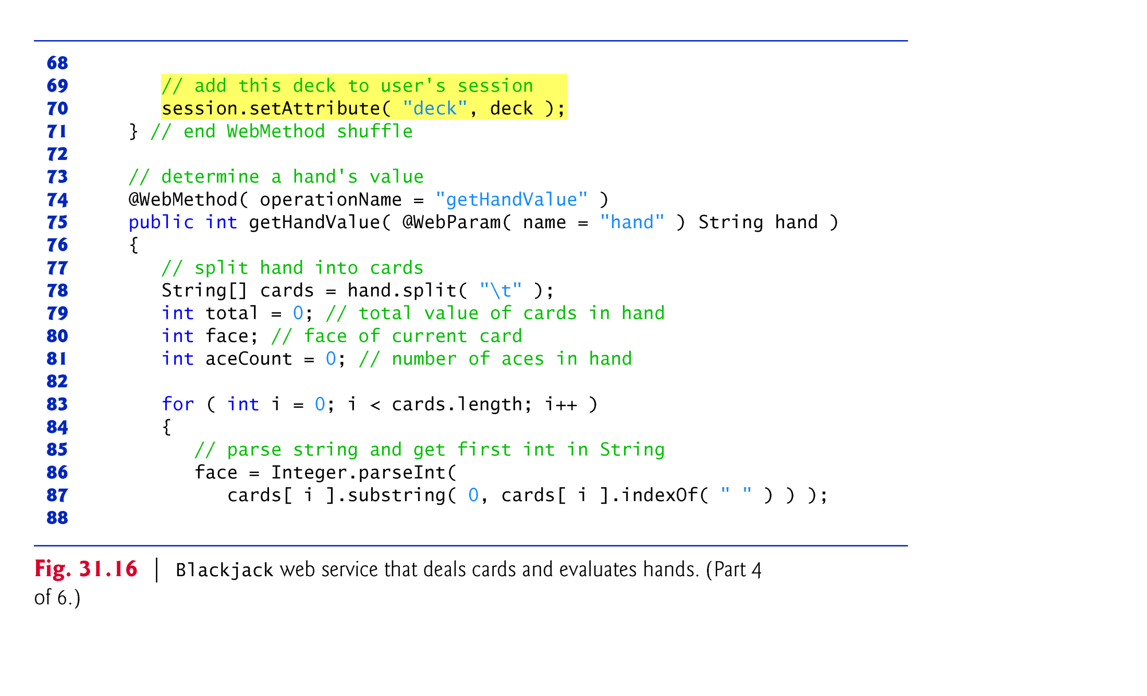

Slide 75
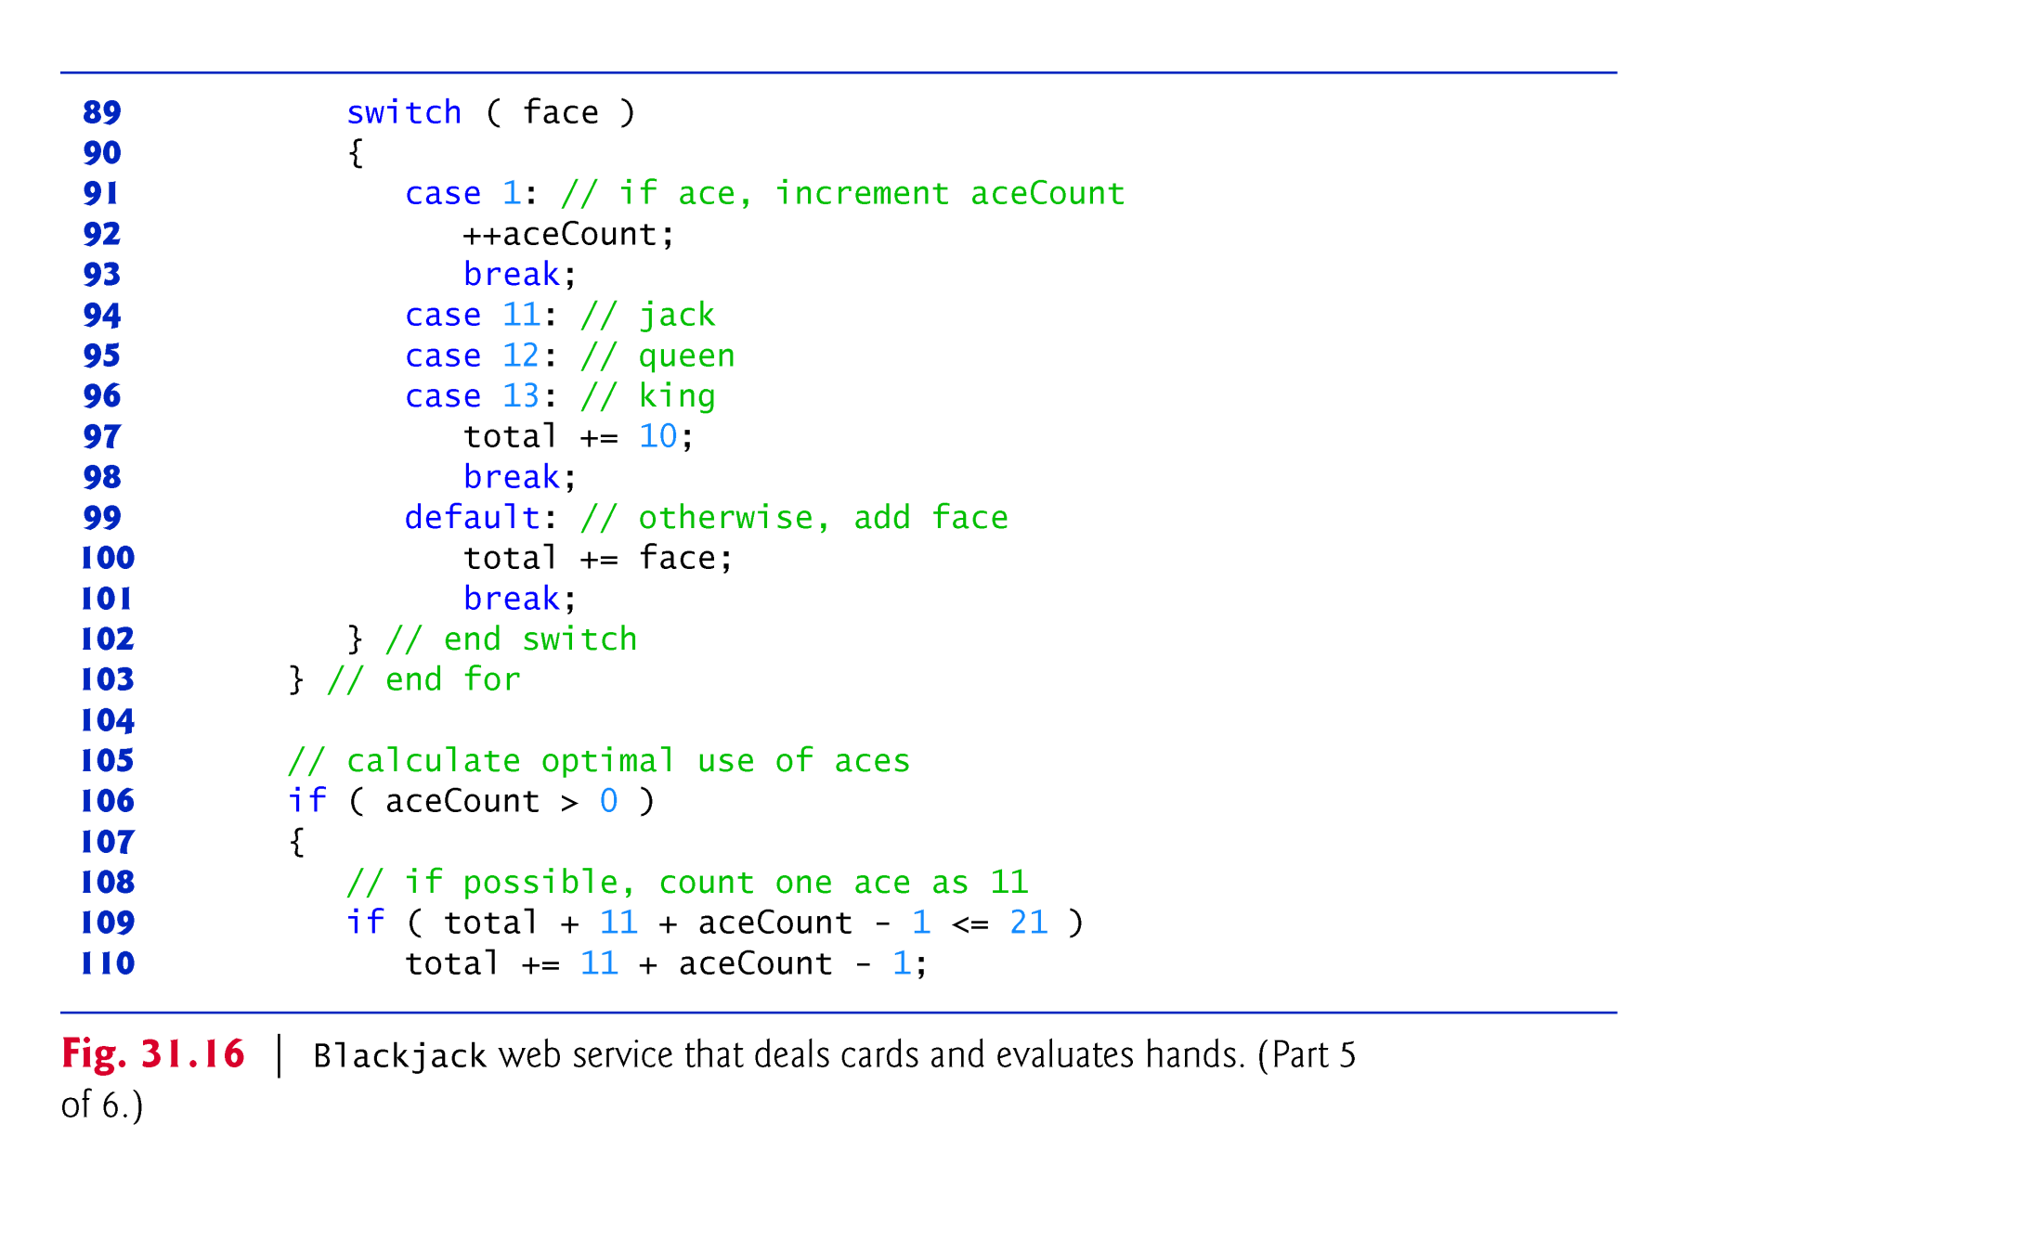

Slide 76
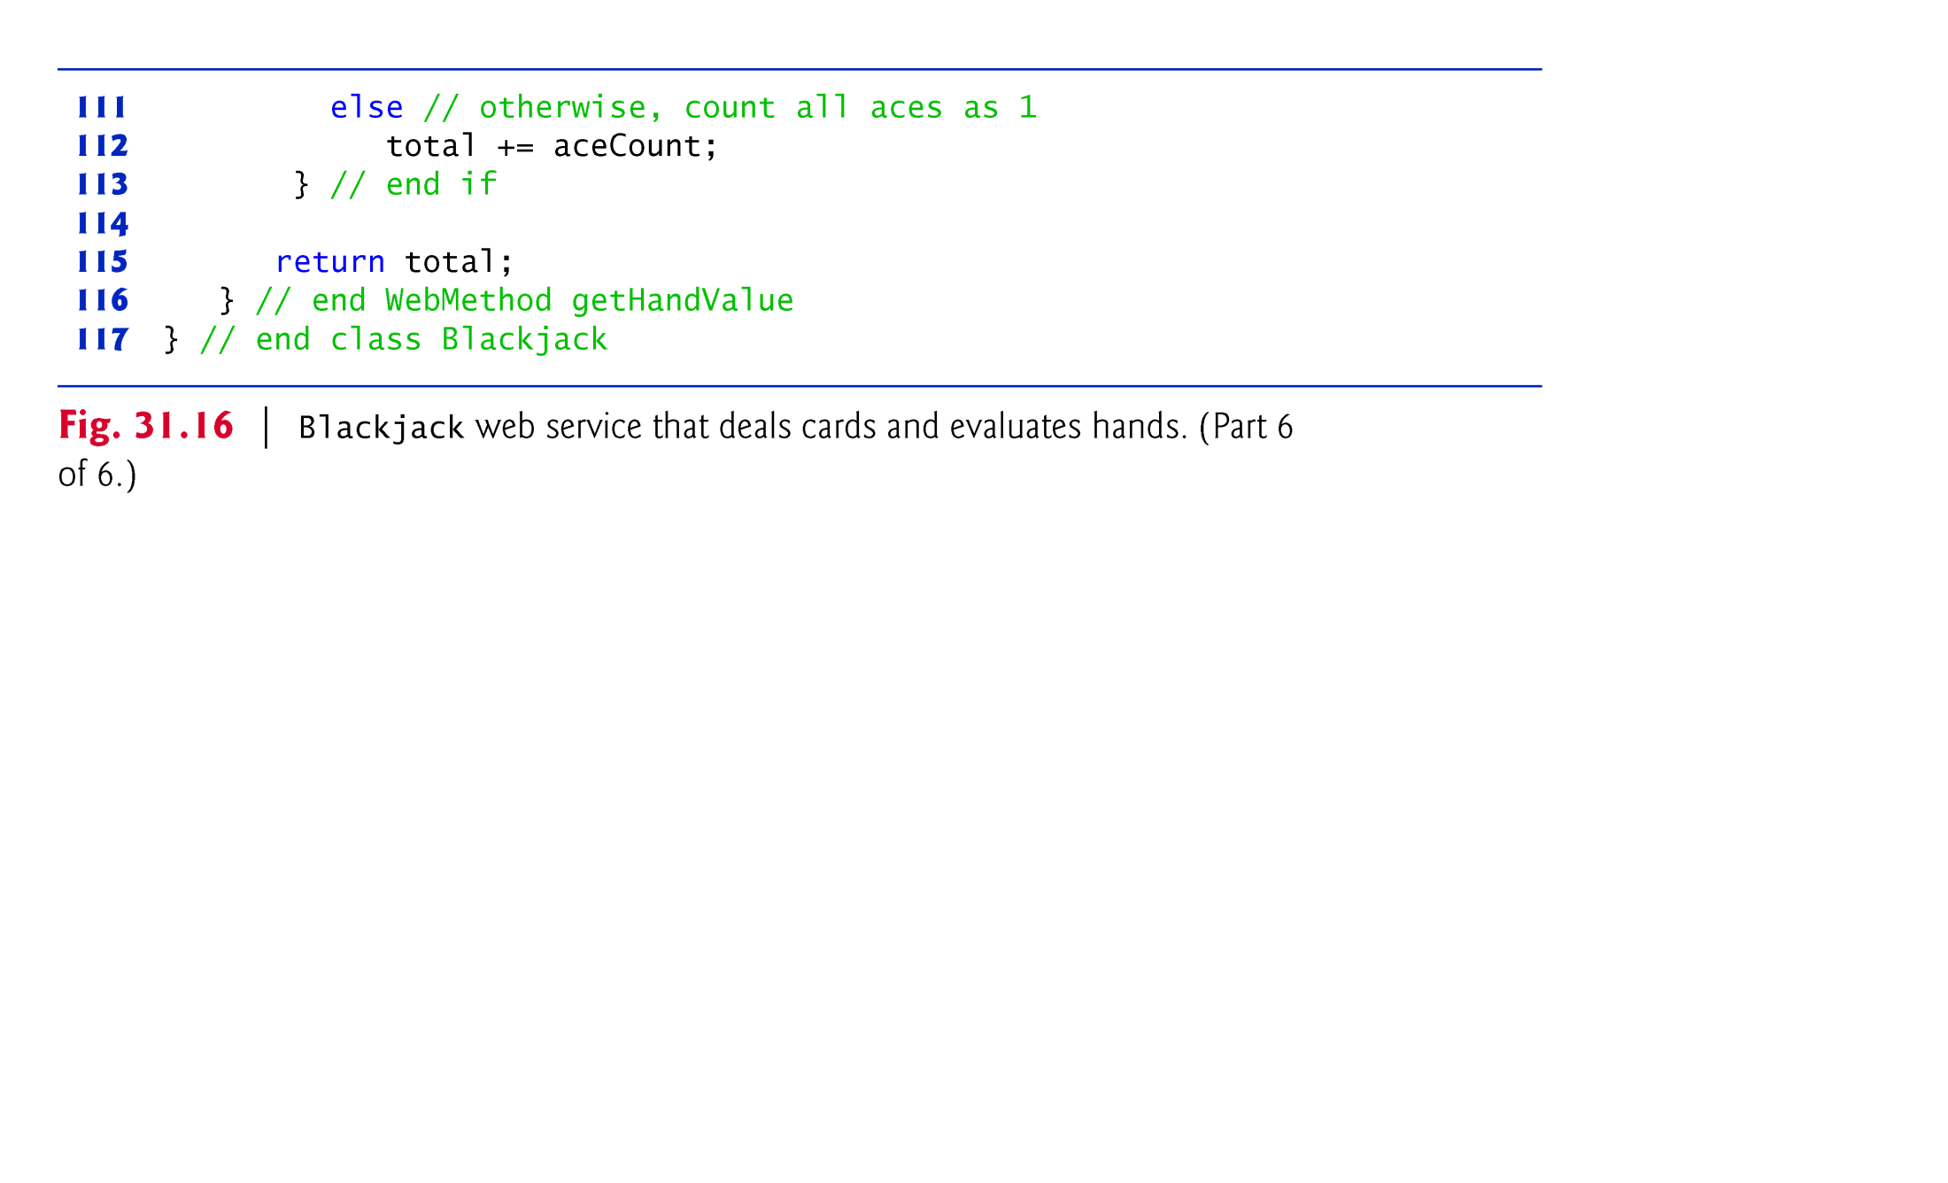

Slide 77
31.9.1 Creating a Blackjack Web Service (cont.)
A client first calls the Blackjack web service’s shuffle method to shuffle the deck of cards and place it into an HttpSession object that is specific to that client.
To use session tracking in a web service, you must include code for the resources that maintain the session-state information.
Handled for you via the @Resource- annotation.
Enables tools like NetBeans to “inject” support objects into your class, thus allowing you to focus on your business logic rather than the support code.
The server is responsible for initializing the support objects.
The concept of using annotations to add code that supports your classes is known as dependency injection.

Slide 78
31.9.1 Creating a Blackjack Web Service (cont.)
Line 20 injects a WebServiceContext object into your class.
Enables a web service to access and maintain information, such as session state for a specific request.
An object that implements interface MessageContext will be used to obtain an HttpSession object for the current client.
MessageContext method get helps us obtain the HttpSession object for the current client.
Method get receives a constant indicating what to get from the MessageContext.
The constant MessageContext.SERVLET_REQUEST indicates that we’d like to get the HttpServlet-Request object for the current client.
We then call the HttpServlet-Request method getSession to obtain the HttpSession object.

Slide 79
31.9.1 Creating a Blackjack Web Service (cont.)
HttpSession method setAttribute inserts data into the HttpSession.
Method getAttribute takes as a parameter a String that identifies the Object to obtain from the session state.
The HttpSession can store many Objects, provided that each has a unique identifier.

Slide 80
31.9.2 Consuming the Blackjack Web Service
The blackjack application in Fig. 31.17 keeps track of the player’s and dealer’s cards, and the web service tracks the cards that have been dealt.

Slide 81
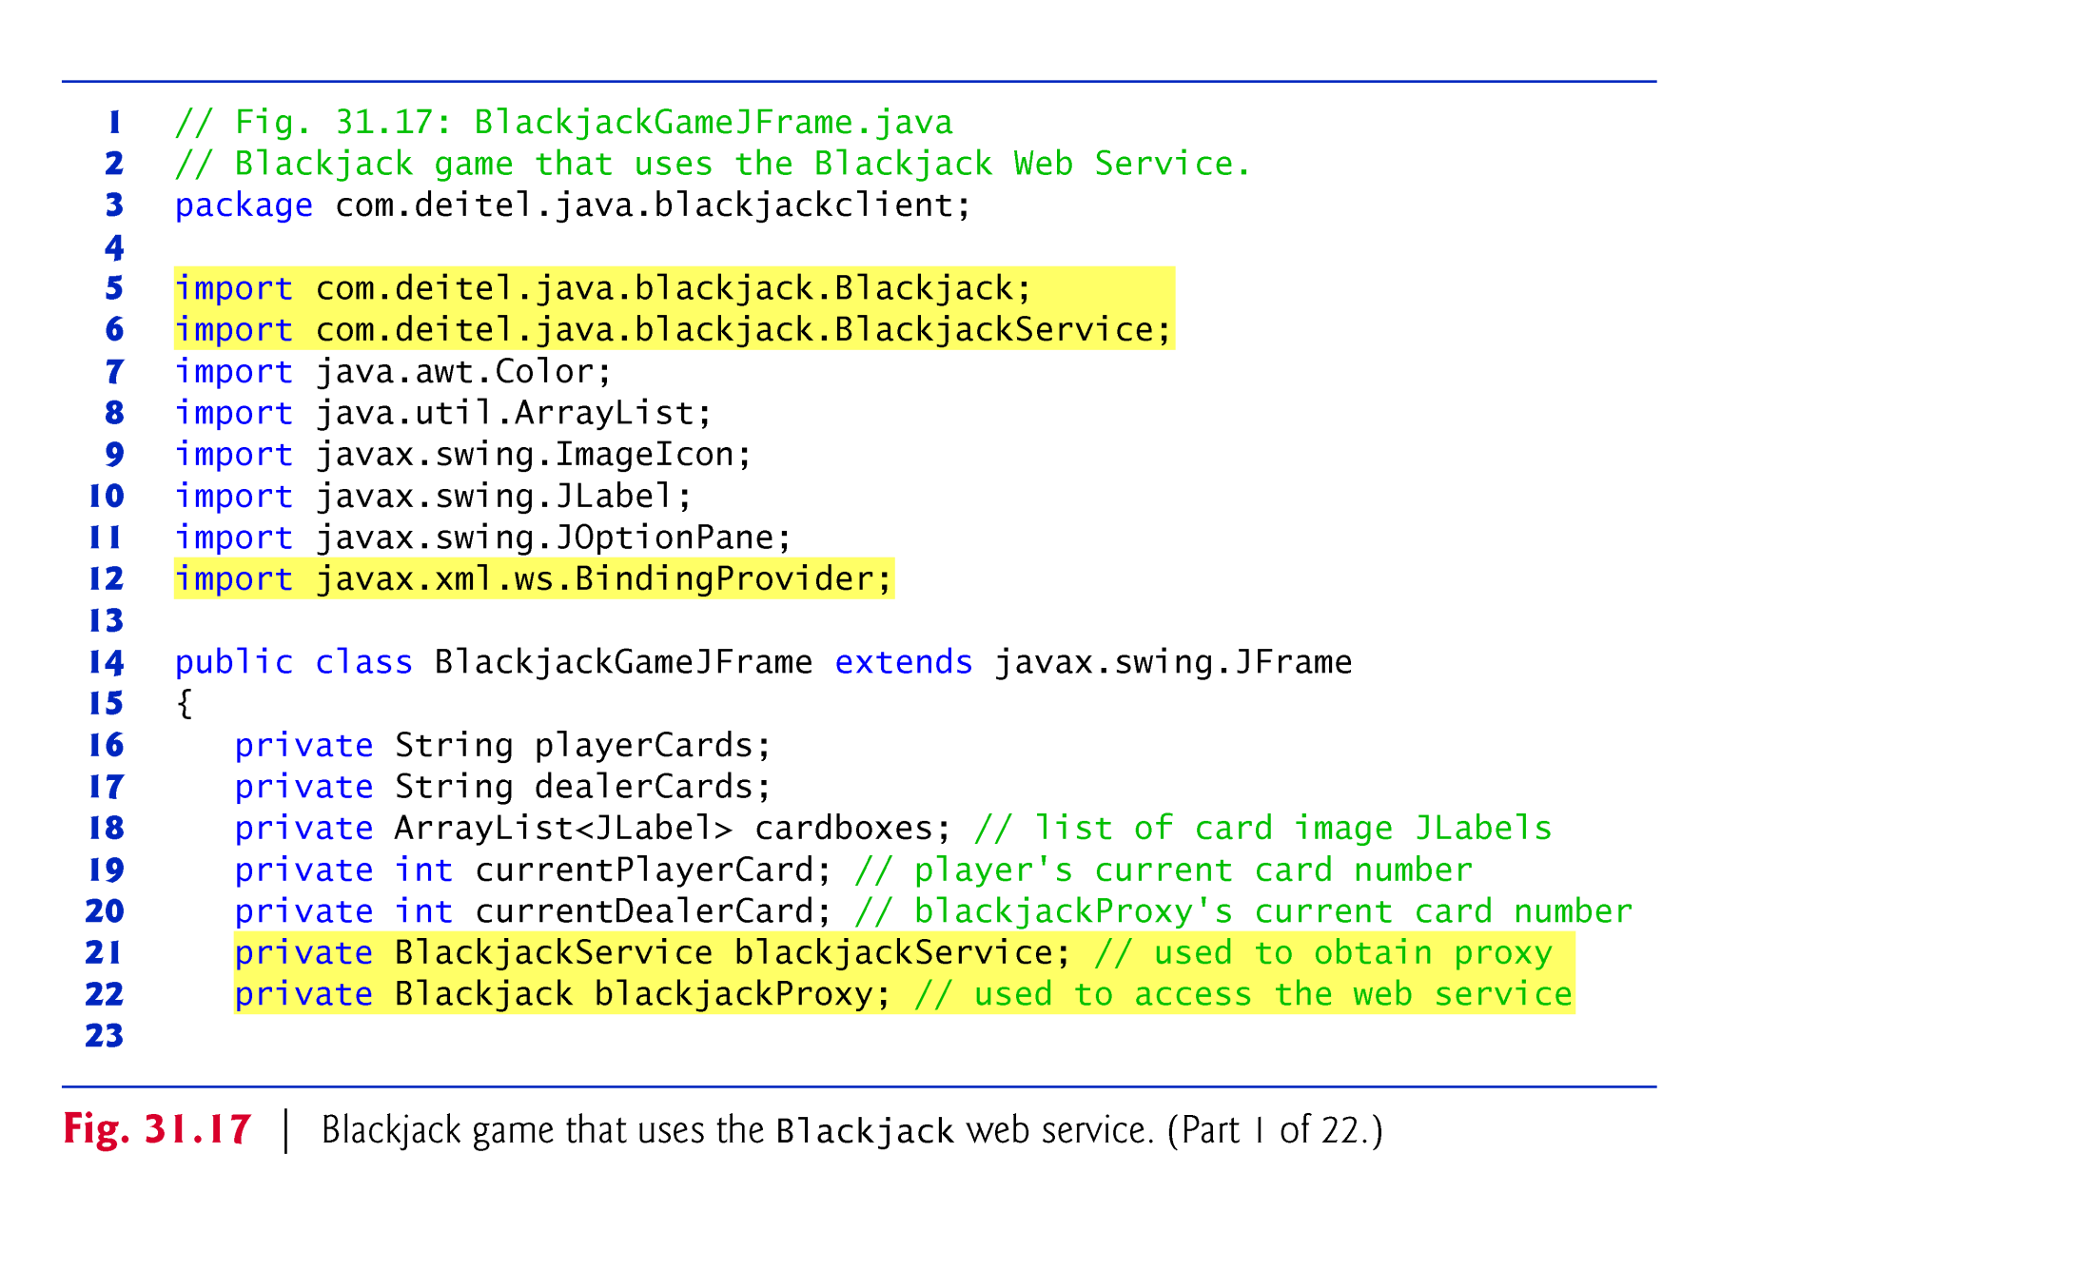

Slide 82
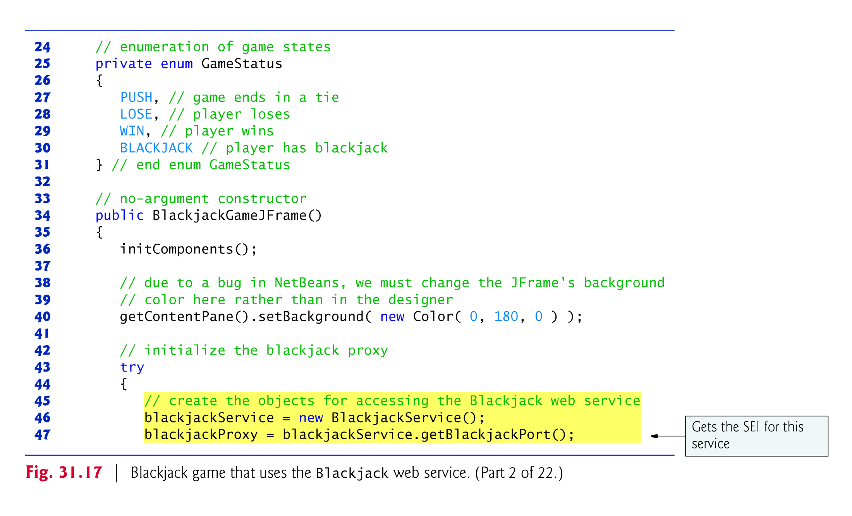

Slide 83
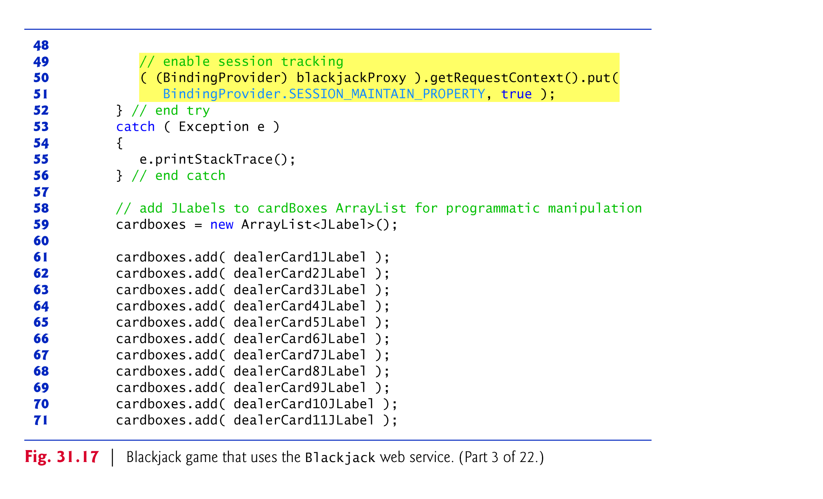

Slide 84
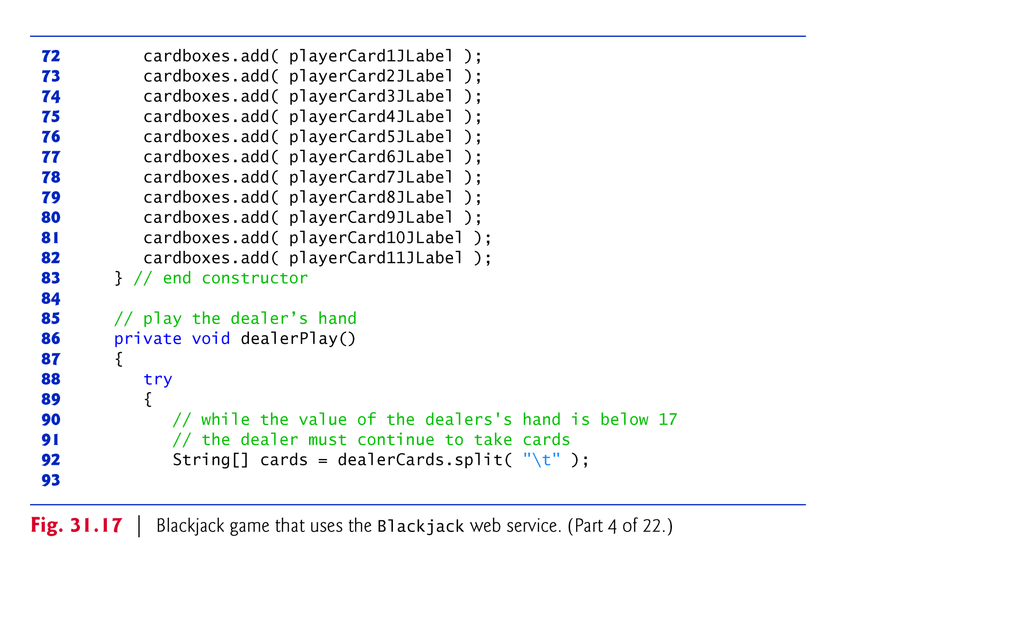

Slide 85
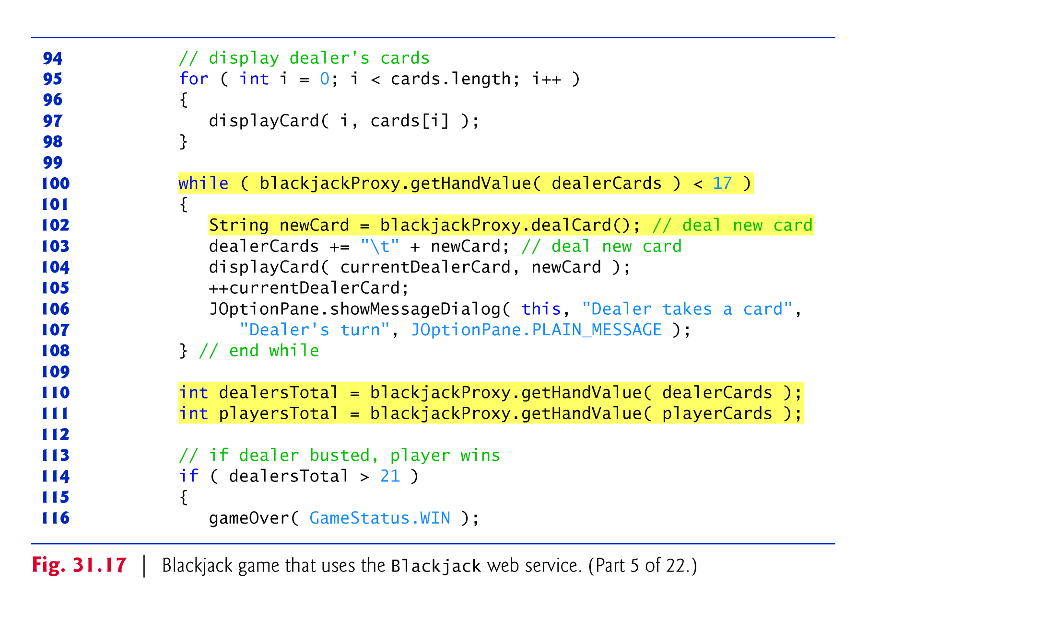

Slide 86
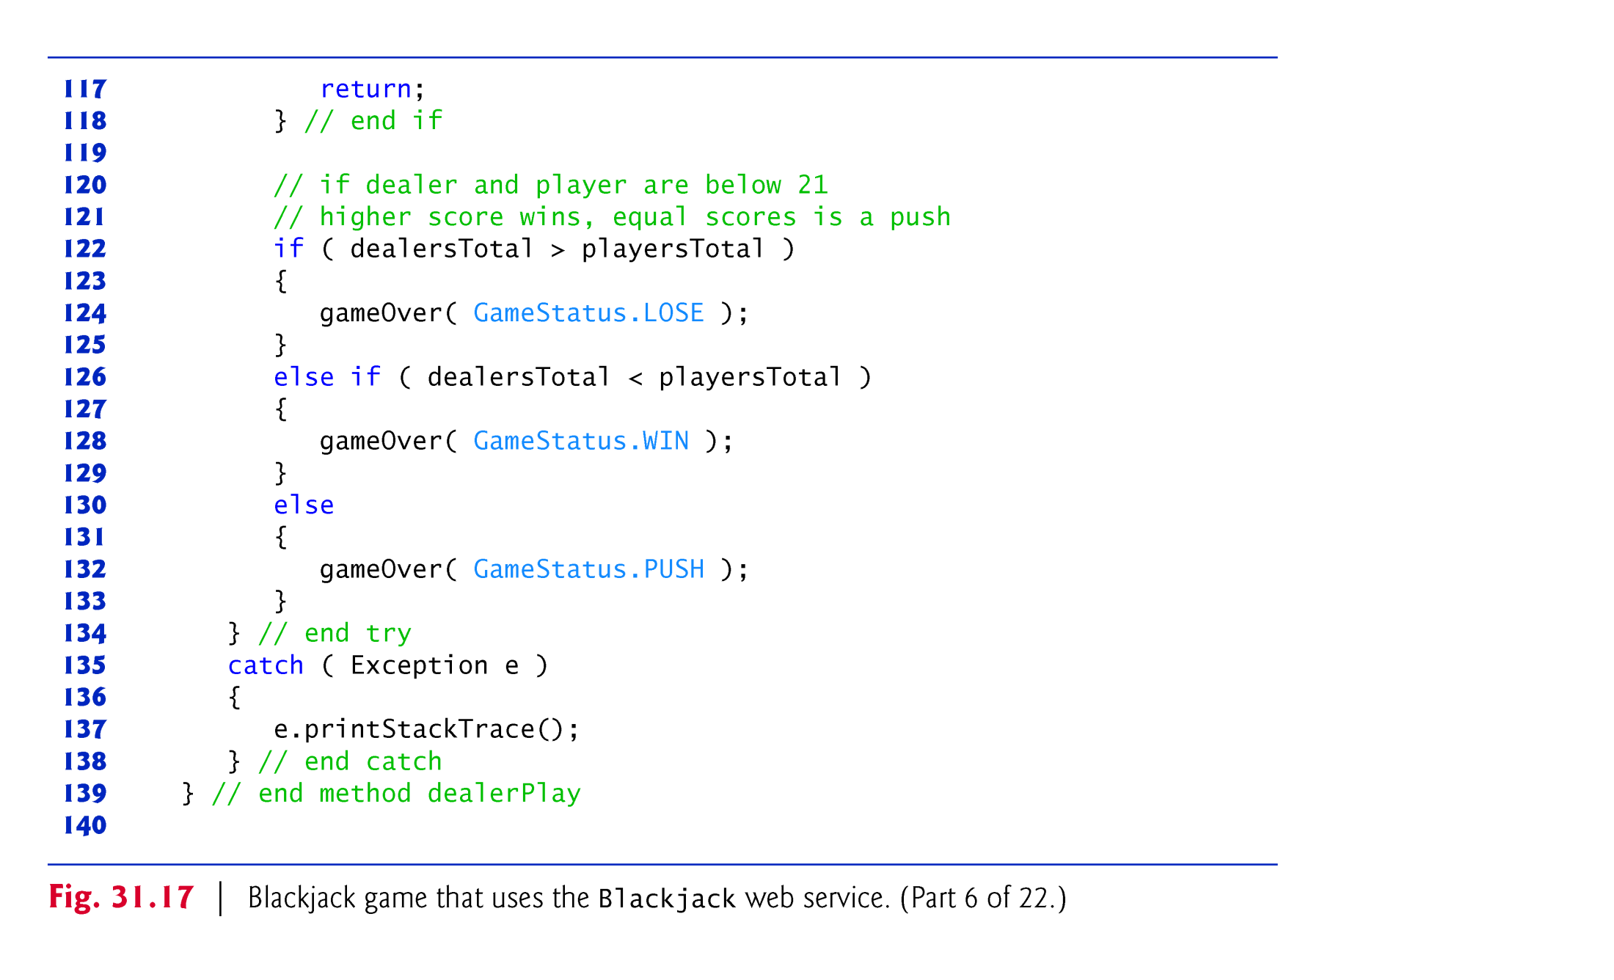

Slide 87
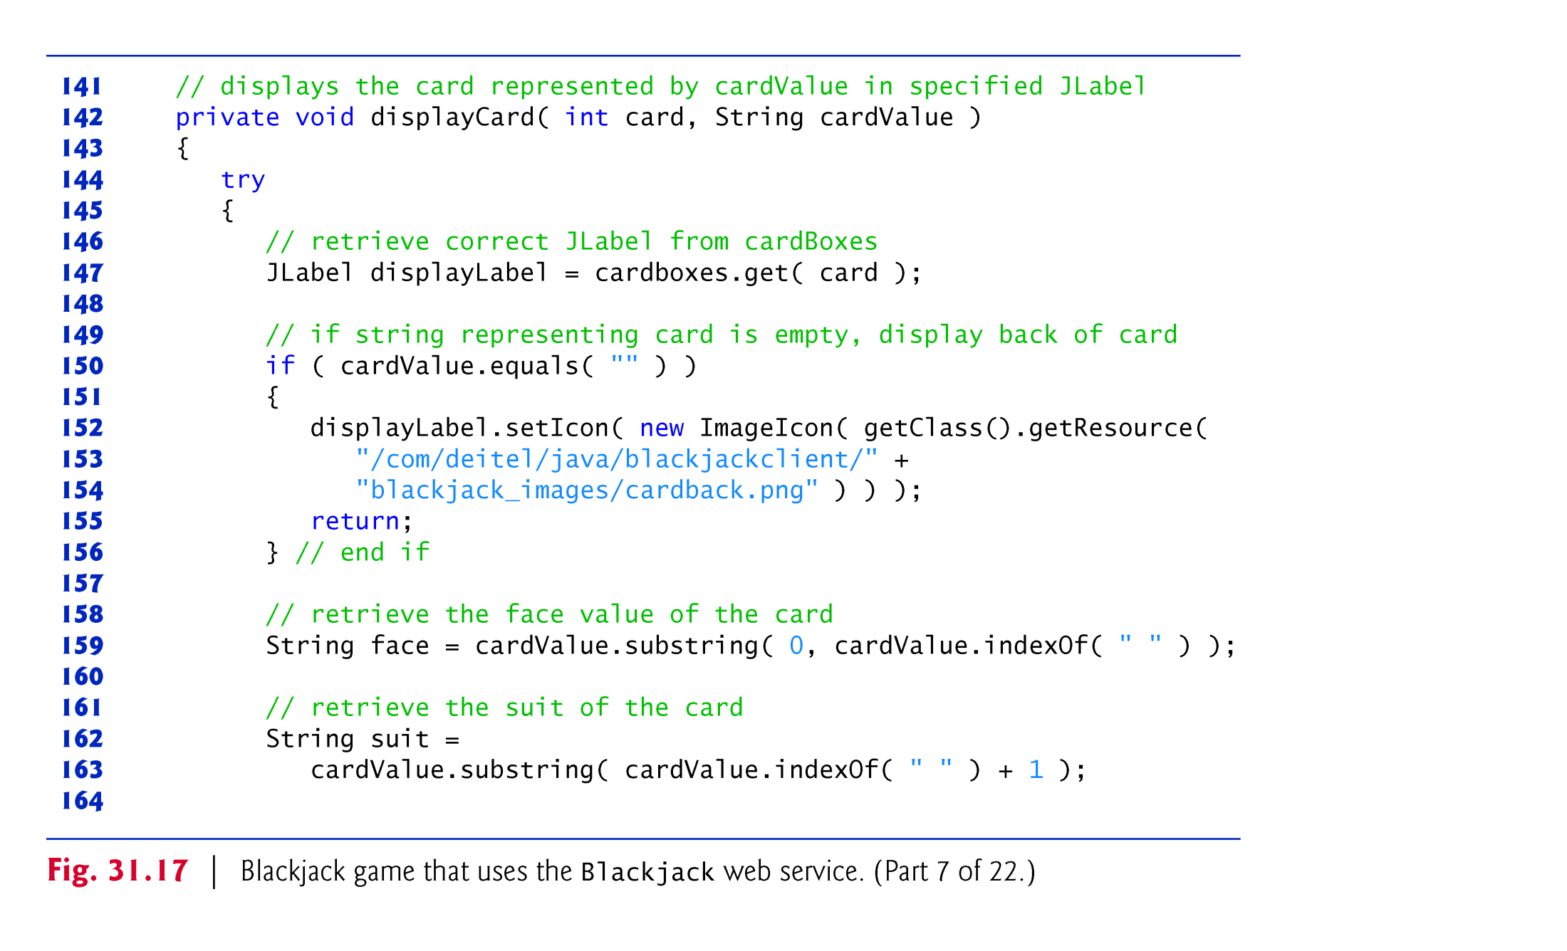

Slide 88
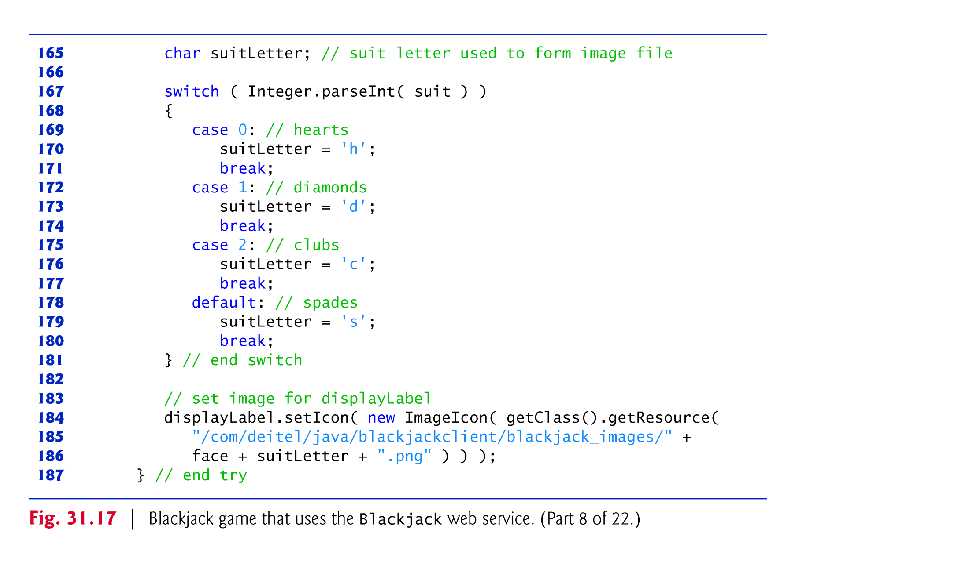

Slide 89
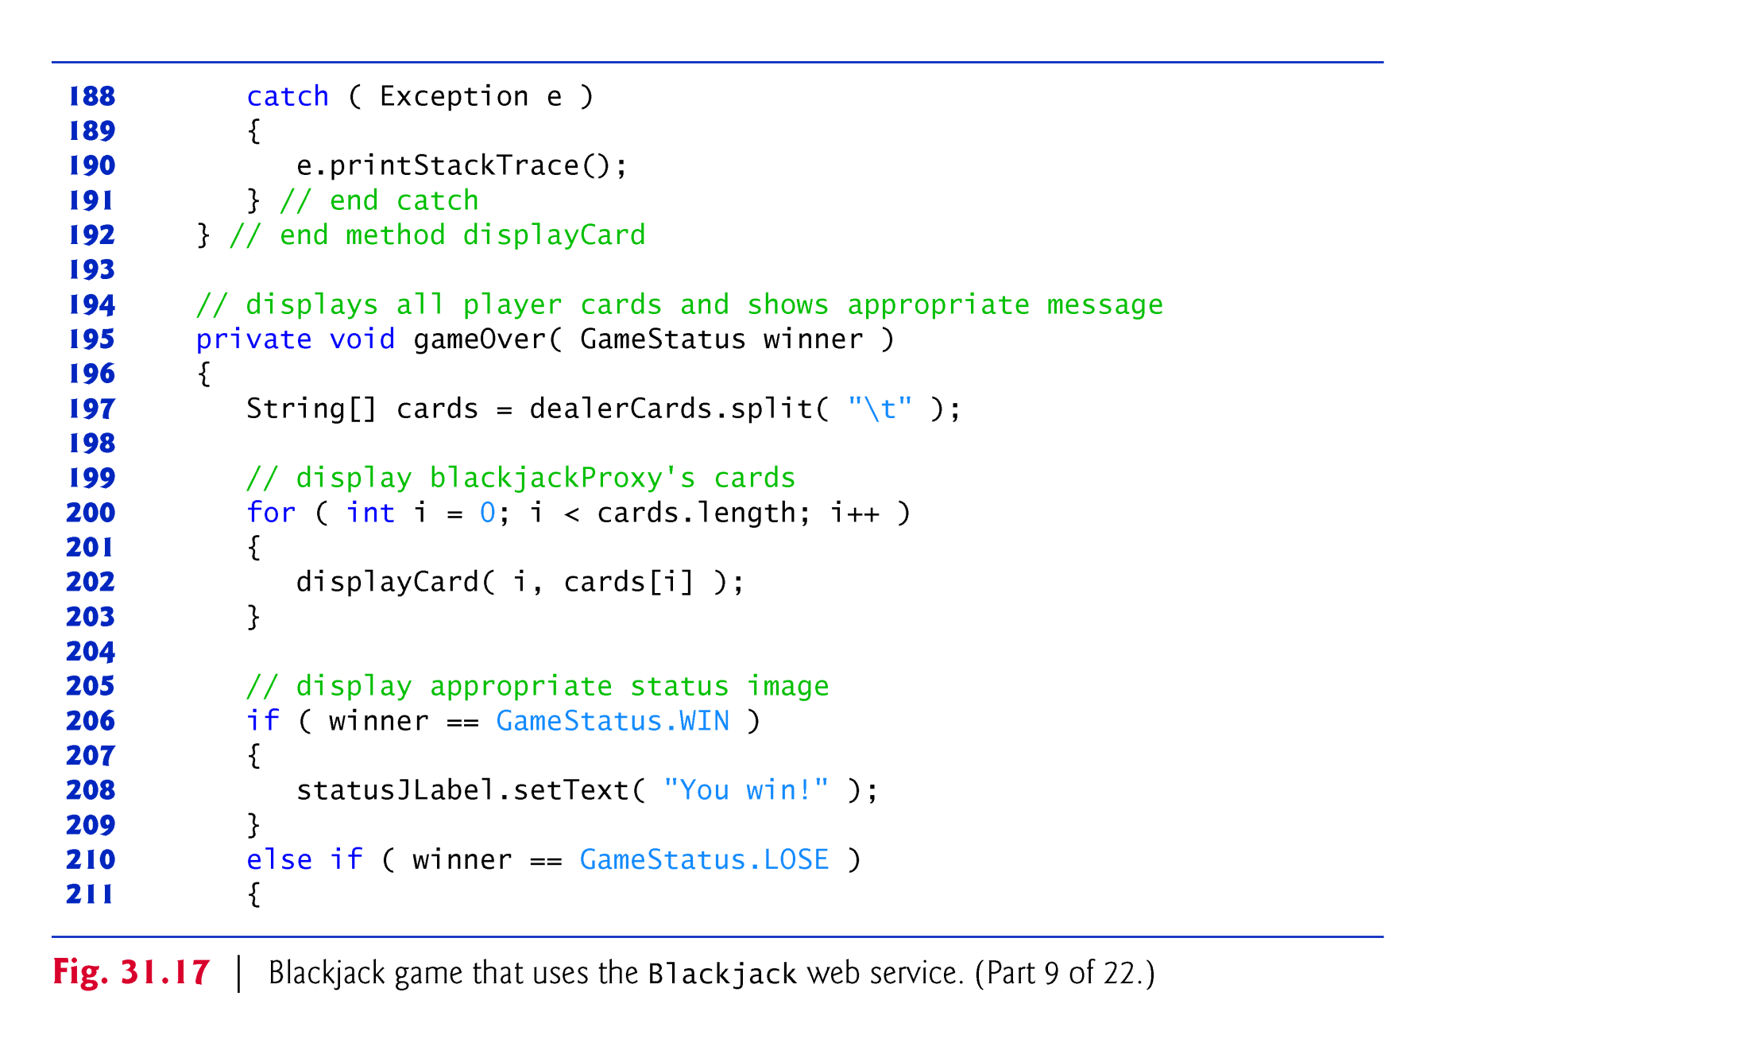

Slide 90
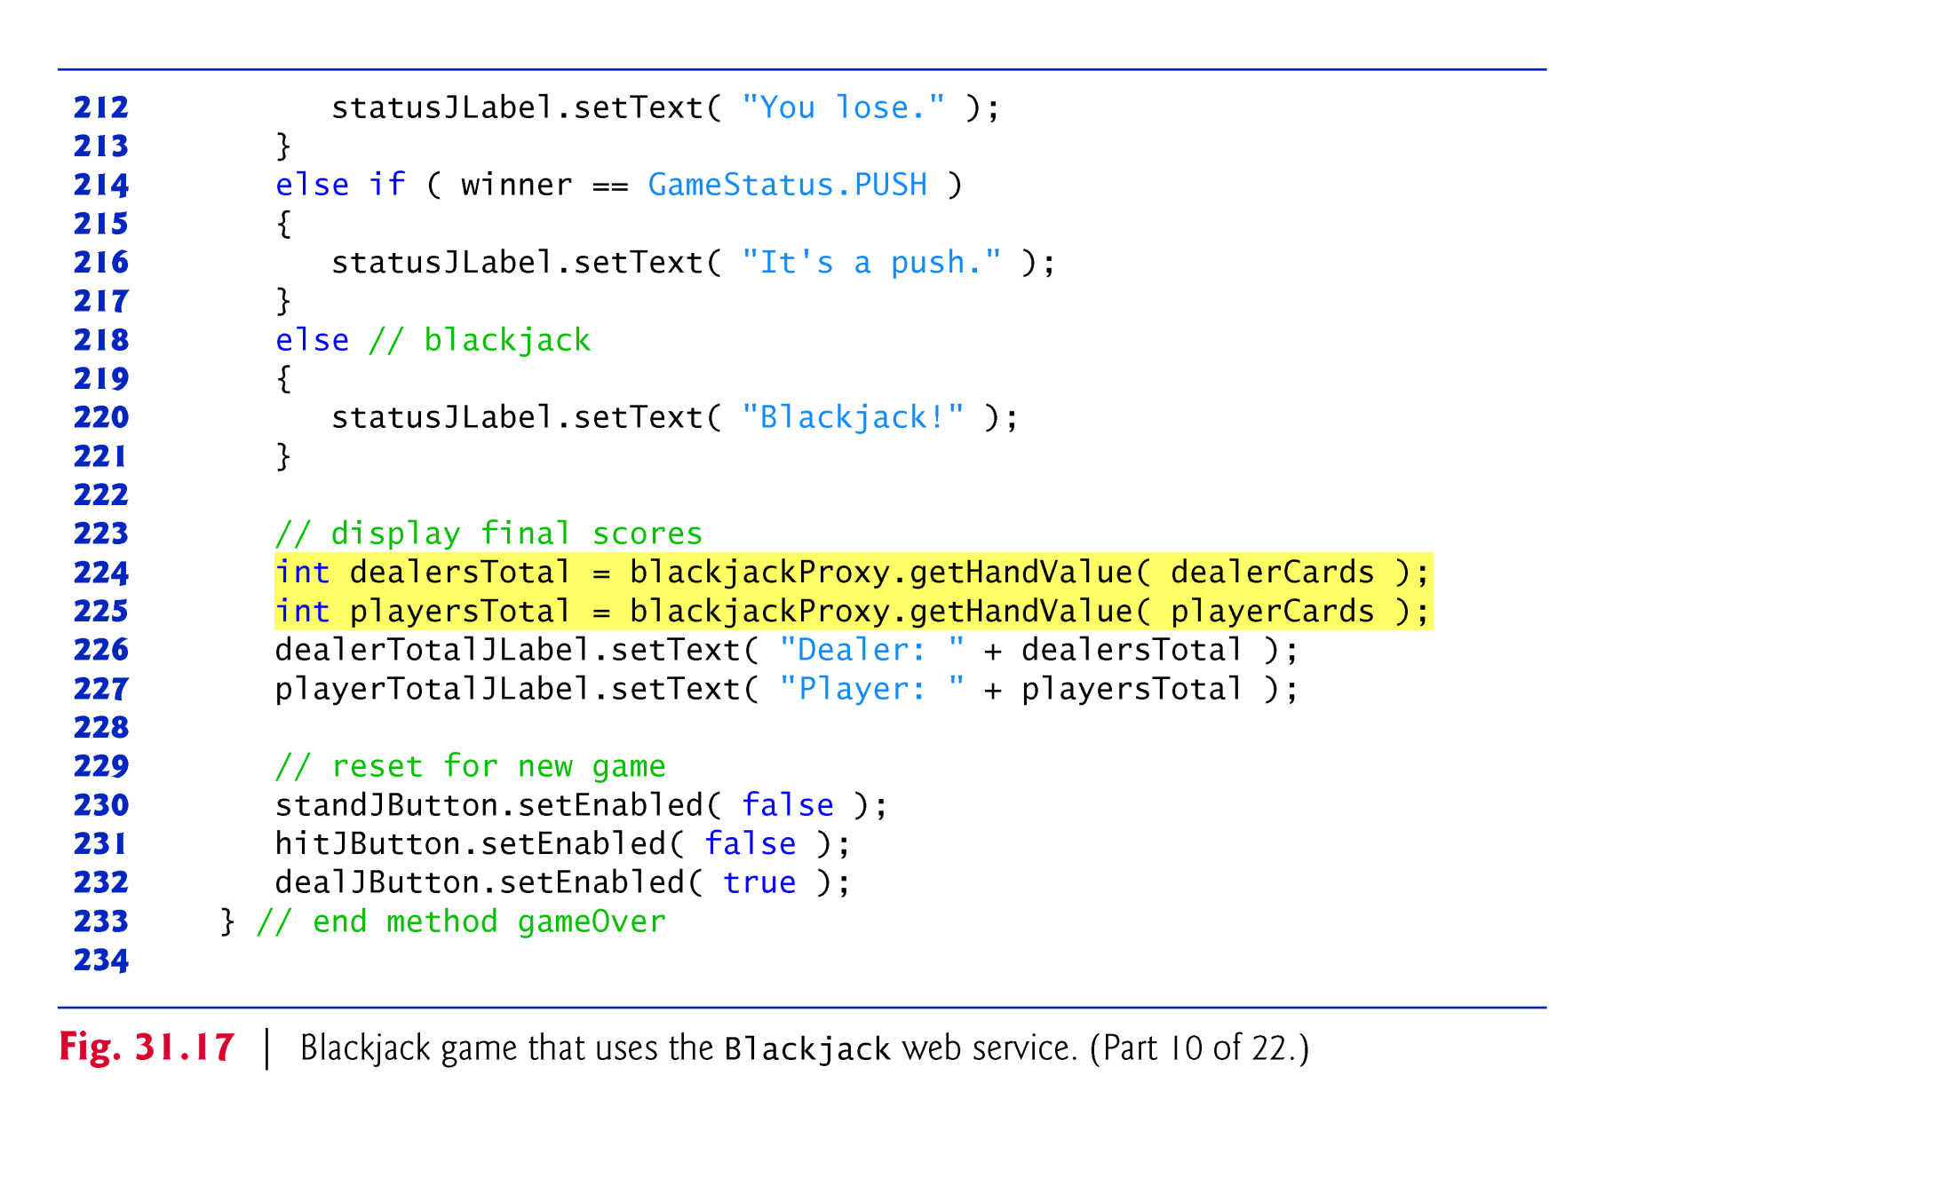

Slide 91
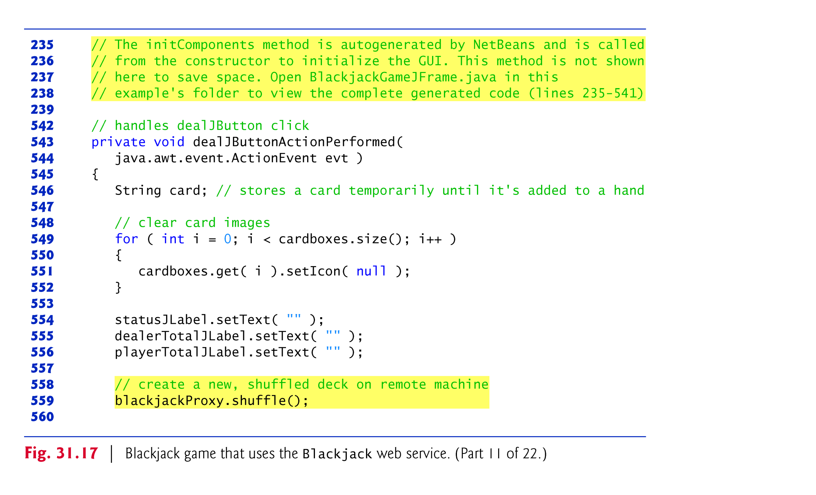

Slide 92
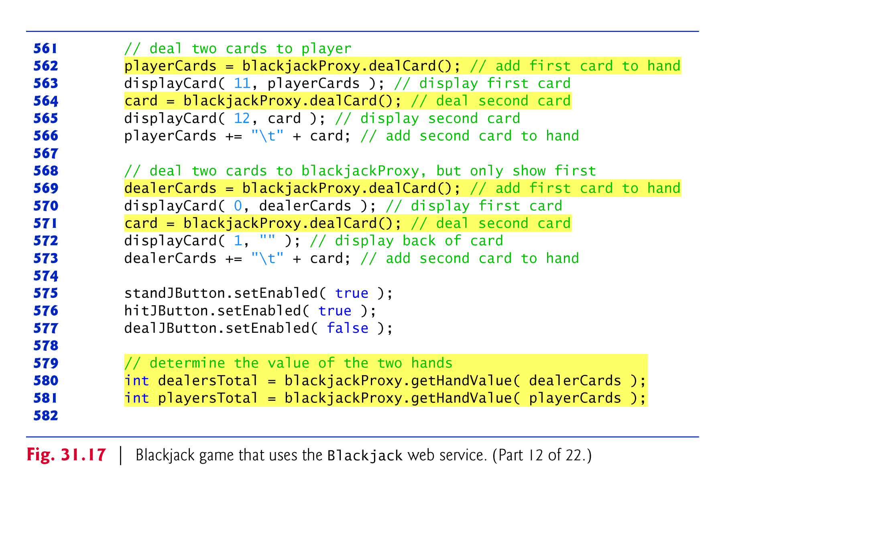

Slide 93
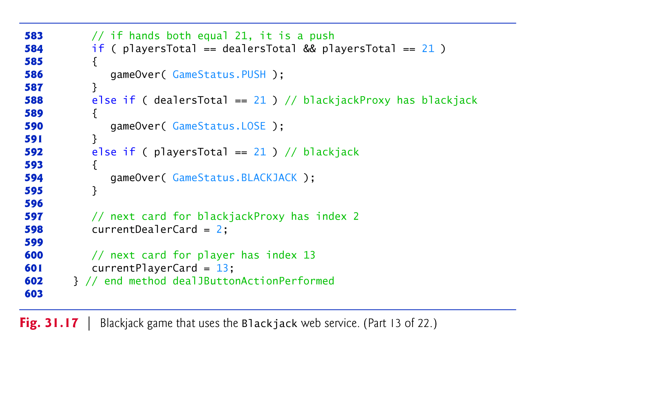

Slide 94


Slide 95


Slide 96


Slide 97


Slide 98


Slide 99


Slide 100


Slide 101


Slide 102


Slide 103
31.9.2 Consuming the Blackjack Web Service (cont.)
With JAX-WS, the client application must indicate whether it wants to allow the web service to maintain session information.
We first cast the service endpoint interface object to interface type BindingProvider.
A BindingProvider enables the client to manipulate the request information that will be sent to the server.
This information is stored in an object that implements interface RequestContext.
The BindingProvider and RequestContext are part of the framework that is created by the IDE when you add a web service client to the application.

Slide 104
31.9.2 Consuming the Blackjack Web Service (cont.)
Next, we invoke the BindingProvider’s getRequestContext method to obtain the RequestContext object.
Then we call the RequestContext’s put method to set the property
BindingProvider.SESSION_MAINTAIN_PROPERTY to true.
This enables the client side of the session-tracking mechanism, so that the web service knows which client is invoking the service’s web methods.

Slide 105
31.10 Consuming a Database-Driven SOAP-Based Web Service
In this section, we present an airline reservation web service that receives information regarding the type of seat a customer wishes to reserve and makes a reservation if such a seat is available.
Later in the section, we present a web application that allows a customer to specify a reservation request, then uses the airline reservation web service to attempt to execute the request.

Slide 106
31.10.1 Creating the Reservation Database
Reservation database containing a single table named Seats to locate a seat matching a client’s request.
The sample data is shown in Fig. 31.18.

Slide 107


Slide 108


Slide 109


Slide 110


Slide 111


Slide 112


Slide 113
31.10.2 Creating a Web Application to Interact with the Reservation Service
This section presents a ReservationClient web application that consumes the Reservation web service.
The application allows users to select seats based on class ("Economy" or "First") and location ("Aisle", "Middle" or "Window"), then submit their requests to the airline reservation web service.
If the database request is not successful, the application instructs the user to modify the request and try again.

Slide 114


Slide 115


Slide 116


Slide 117


Slide 118


Slide 119


Slide 120


Slide 121


Slide 122


Slide 123


Slide 124
31.11 Equation Generator: Returning User-Defined Types
Most of the web services we’ve demonstrated received and returned primitive-type instances.
It’s also possible to process instances of class types in a web service.
This section presents a RESTful EquationGenerator web service that generates random arithmetic equations of type Equation.
The client is a math-tutoring application that accepts information about the mathematical question that the user wishes to attempt (addition, subtraction or multiplication) and the skill level of the user (1 specifies equations using numbers from 1 through 9, 2 specifies equations involving numbers from 10 through 99, and 3 specifies equations containing numbers from 100 through 999).
The web service then generates an equation consisting of random numbers in the proper range.
The client application receives the Equation and displays the sample question to the user.

Slide 125
31.11 Equation Generator: Returning User-Defined Types
We define class Equation in Fig. 31.22.
The only requirement for serialization and deserialization to work with the JAXB and Gson classes is that class Equation must have the same public properties on both the server and the client.
Such properties can be public instance variables or private instance variables that have corresponding set and get methods.

Slide 126


Slide 127


Slide 128


Slide 129


Slide 130


Slide 131
31.11.1 Creating the REST-Based XML EquationGenerator Web Service
Figure 31.23 presents the EquationGeneratorXML web service’s class for creating randomly generated Equations.
Method getXml (lines 19–38) takes two parameters—a String representing the mathematical operation ("add", "subtract" or "multiply") and an int representing the difficulty level.
JAX-RS automatically converts the arguments to the correct type and will return a “not found” error to the client if the argument cannot be converted from a String to the destination type.
Supported types for conversion include integer types, floating-point types, boolean and the corresponding type-wrapper classes.

Slide 132


Slide 133


Slide 134
31.11.2 Consuming the REST-Based XML EquationGenerator Web Service
The EquationGeneratorXMLClient application (Fig. 31.24) retrieves an Equation object formatted as XML from the EquationGeneratorXML web service.
The client application then displays the left-hand side of the Equation and waits for user to evaluate the expression and enter the result.

Slide 135


Slide 136


Slide 137


Slide 138


Slide 139


Slide 140


Slide 141


Slide 142
31.11.2 Consuming the REST-Based XML EquationGenerator Web Service (cont.)
The event handler for generateJButton constructs the URL to invoke the web service, then passes this URL to the unmarshal method, along with an instance of Class<Equation>, so that JAXB can convert the XML into an Equation object.

Slide 143
31.11.3 Creating the REST-Based JSON EquationGenerator Web Service
As you saw in Section 31.8, RESTful web services can return data formatted as JSON as well.
Figure 31.25 is a reimplementation of the EquationGeneratorXML service that returns an Equation in JSON format.
The logic implemented here is the same as the XML version except that we use Gson to convert the Equation object into JSON instead of using JAXB to convert it into XML.
Note that the @Produces annotation has also changed to reflect the JSON data format.

Slide 144


Slide 145


Slide 146
31.11.4 Consuming the REST-Based JSON EquationGenerator Web Service
The program in Fig. 31.26 consumes the EquationGeneratorJSON service and performs the same function as EquationGeneratorXMLClient—the only difference is in how the Equation object is retrieved from the web service.
We use the URL class and an InputStreamReader to invoke the web service and read the response.
The retrieved JSON is deserialized using Gson and converted back into an Equation object.

Slide 147


Slide 148


Slide 149


Slide 150


Slide 151


Slide 152


Slide 153


